Slide 1
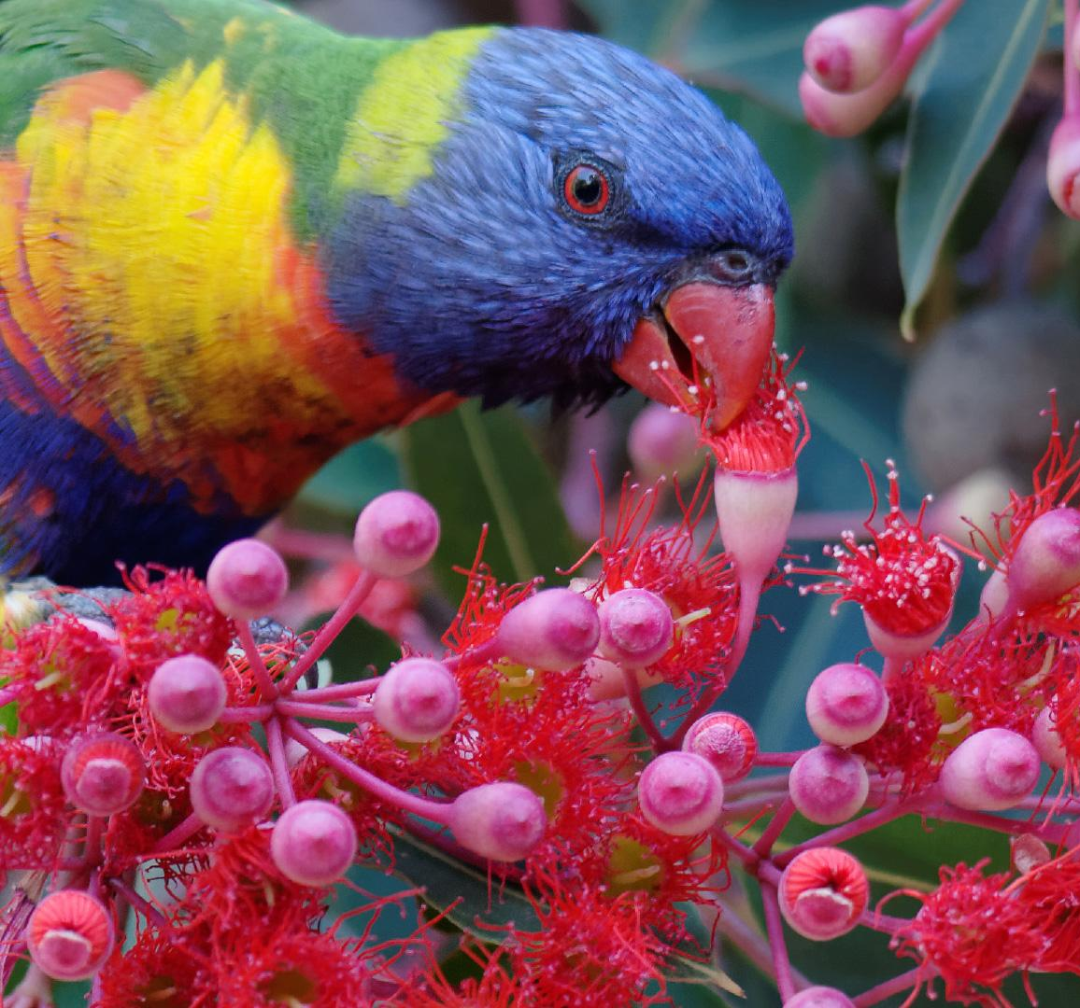
Kindergarten 2024
Parent Information Evening
2nd November 2023

Slide 2
Acknowledgement of Country
We are grateful to be able to show our respect to the Traditional People of this land, the Elders past, present and upcoming. We are honoured to be able to learn and play on this land surrounded by the ocean, bushland and the waterways of Pittwater. Our hope for the future is for a better understanding of our local history and culture.

Slide 3
Presented by Kindy team 2023
Jane Pimentel (Assistant Principal)
K Purple – Katherine Rophail
K Silver – Sienna Dusting
K Blue – Marie Leacy
Apologies from Mr Huskins (K Lime) and
Mrs Du Bois (K Orange)

Slide 4
Mona Vale Public School Parents and Citizens
Mr Matt Harris – joint Vice President
Mrs Bec Gilfillan – Treasurer
How can I involve myself in the Mona Vale Community?
How do I become a volunteer?
Importance of a strong P and C.

Slide 5
Term Dates 2024
Staff Development Days – a time for professional learning for teachers, Tuesday 30th and Wednesday 31st January 2024
Yrs 1 – 6: Students start school: Thursday 1st February 2024
Best Start Interviews: Thursday 1st and Friday 2nd February 2024
Kindergarten students start: Monday 5th February 2024

Slide 6
Orientation Days
Students are invited to attend the orientation days and you will have received your email with your child’s ‘colour group’. These are not your classes for 2024.
3 consecutive sessions – Wednesday 15th , 22nd, 29th November 2023
Time: 9:15am – 10:45am
Please refer to the email for all details. You will drop your child to the classroom and then enjoy some ‘me time’.
Transition activity packs and Best Start appointment times will be given out at the last orientation session.

Slide 7
Best Start Assessment
Who will be involved?
All Kindergarten students in NSW Public Schools take part in the Best Start interviews. We will have our Kindy team, myself and Learning Support Teachers.
When will this take place?
At the start of the school year on the first 2 days of school.
What is the Best Start Assessment?
An interview with each child to assess their literacy and numeracy skills when they start school.

Slide 8
What is the Best Start Interview for?
To provide information that supports teachers in meeting students’ individual learning needs;
To provide parents and caregivers with feedback on what their child can do, and how they can best support their child’s learning; and
To assist the monitoring of student learning throughout the school years.

Slide 9
How will student assessment information be communicated to
parents and caregivers?
During our Parent / Teacher interviews at the start of the year, you will receive clear, accessible feedback on:
next steps in the learning process
your child’s learning at school entry
how to support your child’s learning throughout their first year at school

Slide 10
Frequently asked questions
Does my child need to study?
Does my child need to know how to read and count to 30?
What if my child can’t answer any questions?
What if they refuse to do it?
What if they fail the test?

Slide 11
What curriculum areas will your child be engaged in?
English, Mathematics,
History, Geography,
Personal Development Health and Physical Education,
Creative Arts
Science, Library

Slide 12
English – Phonological Awareness, Phonics, Oral Communication,
Reading, Writing
Mathematics – Number and Algebra, Measurement and Space,
Statistics and Probability
Together these make up 50% of our learning time

Slide 13
Science - 4 topics Living World, Material World, Physical, Earth and Space and Weather
History Personal and Family Histories
Geography
People live in Places
P.D.H.P.E delivered by Specialist Sports Teachers (sports houses)
C.A.P.A – Drama, Dance and Visual Art
Music delivered by Specialist Music Teachers

Slide 14
Students are allocated to a particular house group.
House groups and colours are:
Wear sport uniform and sport shoes.
Class teacher will notify parents when sport lessons are scheduled.
BARRENJOEY
HAWKESBURY
PITTWATER
WARRINGAH

Slide 15
Reading – READ, READ, READ
Children who enjoy books are always more enthusiastic to learn to read.
Practise holding a book correctly and turning the pages.
Ask questions about what you’ve read. For example:
What happened next?
What was your favourite part?
Read poems and Nursery Rhymes.
Poetry develops phonemic awareness (e.g. ability to hear rhyme, distinguish sounds etc) which is the single biggest predictor of future reading ability.

Slide 16
Oral Communication
Encourage your child to talk about familiar objects and events.
Following simple 2 step instructions, e.g. put on your pyjamas, then go and brush your teeth.
Encourage your child to communicate their needs, e.g. I’m thirsty, please may I have a drink. Please may I go to the toilet?
This will assist when they have to talk in front of their class for news or feel confident to put their hand up and answer a question or offer some ideas to their teacher.

Slide 17
Writing
Allow your child to use a variety of tools to draw, scribble or write known words.
Provide opportunities to develop their fine motor skills.
Play dough, Lego, painting (finger), scissors, stickers, cooking, colouring, bead threading etc.
Encourage a functional pencil grip and hand preference.

Slide 18
Mathematics
As a parent or carer, you play a vital role in how your child thinks and feels about maths. Even if it wasn’t your favourite subject when you went to school, maths is all around us.
There is help along the way! https://education.nsw.gov.au/parents-and-carers/everyday-maths/primary

Slide 19
NUMBERS – they are everywhere and in everything we do. Make numbers fun, playful and relevant
Play board games – dominoes, dice games, snakes and ladders, uno, card games
Look for lots of incidental learning
Number sense is not taught…… it’s caught!

Slide 20
Simple counting forwards and backwards
Identifying numerals 1-20 and counting out corresponding objects
Matching objects that are similar shape, size or colour.
Making patterns, exploring shapes etc
Goal – to have a flexible understanding of numbers
and the relationship between them

Slide 21
Day to day running!
What do I need to know to set
my child up for success?

Slide 22
In the morning
Upon entering the school, students will drop their bags off in their designated bag drop area, pop their hat on, move to the supervised area and play until the bell rings.
This is your time to say goodbye and leave. Your child will be safe and happy playing with their friends. Please give them confidence and independence……they will settle in quicker this way.
We will always get in contact with you, if there are any concerns……..we promise☺

Slide 23
School Hours
All students should arrive at school between 8:20am - 8:45am so they are ready to start their day
First bell rings at 8:45am - all students can move to their class lines
Second bell rings 8:50am - school start (lessons begin)
Session times
8:50am - 11:10am Session 1
11:10am - 11:40am Recess
11:40am - 12:50pm Session 2
12:50pm - 1:00pm Eating time
1:00pm - 1:30pm Lunch
1:30pm - 2:45 Session 3

Slide 24
How is the day broken up?
2 x 30 min play times during the day
Recess-11:10am
Lunch-12:50pm (10 minute eating time)
Crunch and Sip/Fruit Break
10:00am for 5 - 10 minutes
Small in size, preferably cut up – especially grapes
Small drink of water
Sun Safe Program
Required to wear the school hat during playtime and outdoor activities as a “No Hat – No Play” policy applies

Slide 25
In the afternoon
At the start of the year you will be ask to fill out a form regarding your daily pick up routines.
Students are dismissed from classrooms and will be assisted to: walk to after school care, bus lines or a designated spot. Older siblings are asked to pick up from Kindergarten classrooms.
Two ‘Stop, Kiss and Leave’ Zones – for morning and afternoon
Under no circumstances are students to be dropped off or picked up in staff car parks.
Any student not picked up by 3:00pm will be taken to the office and a call to parents will be made.

Slide 26
Attendance
If your child is absent and you haven’t previously notified your child’s teacher in writing, you will receive an SMS message in the morning. Simply reply with the reason and our rolls will be updated.
Prior approval must be sought from the principal for absences over 10 days. Any absence that has not been approved will be deemed ‘unjustified’.
You must sign your child in and out of the school office if they arrive late or have to leave early.

Slide 27
School Communication
School Website
http://www.monavale-p.schools.nsw.edu.au/
The School App
Download the Flexischools app. Add Mona Vale Public School. (Google play or Apple) and class is ‘new starter’
Newsletters School newsletters are posted on the website and alerted via the app.

Slide 28
Lost Property
All student’s belongings must be labelled clearly with their full name and class.
If you have been given pre-loved uniforms, make sure you change the name.
Must be renamed when they move on to a new class.
Without this, it is impossible for items to be returned or for students to look for them in the lost property basket at the uniform shop.

Slide 29
Medical needs and assistance
Teachers may refer the students to Sick Bay. Staff are qualified in First Aid and will call should you be required to pick up your child.
If your child requires the administration of medication at school, you must complete a form at the office, providing all necessary details.
Medication is NOT to be sent to school with your child. This can only be administered by our office staff. Ensure prior arrangements have been made.

Slide 30
Question Time?

Slide 31
Thank you for joining us tonight.
As a Kindy team we warmly welcome you to our
school community,
and look forward to beginning a
wonderful partnership with you all,
throughout your child’s learning journey.

