Slide 1
WELCOME
KINDERGARTEN 2024

Slide 2
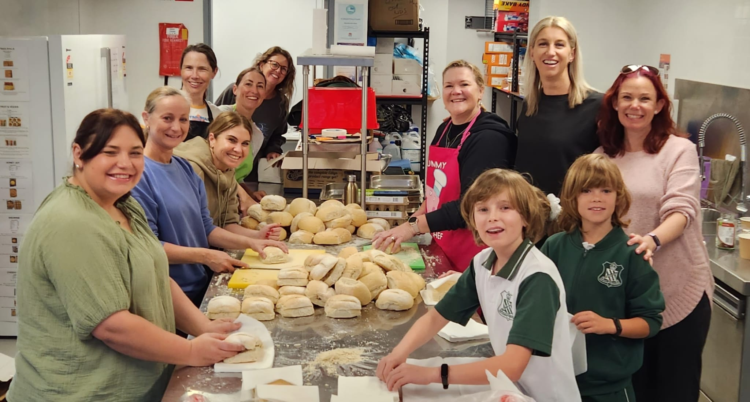
Your P&C: run by you for the kids!
P&C stands for Parents and Citizens of the school community.
MVPS P&C is an incorporated not-for-profit association
promote the interests of the school by bringing parents, citizens, students and teaching staff into close co-operation.
assist in providing facilities and equipment for the school, and in promoting the recreation and welfare of students at the school.

Slide 3
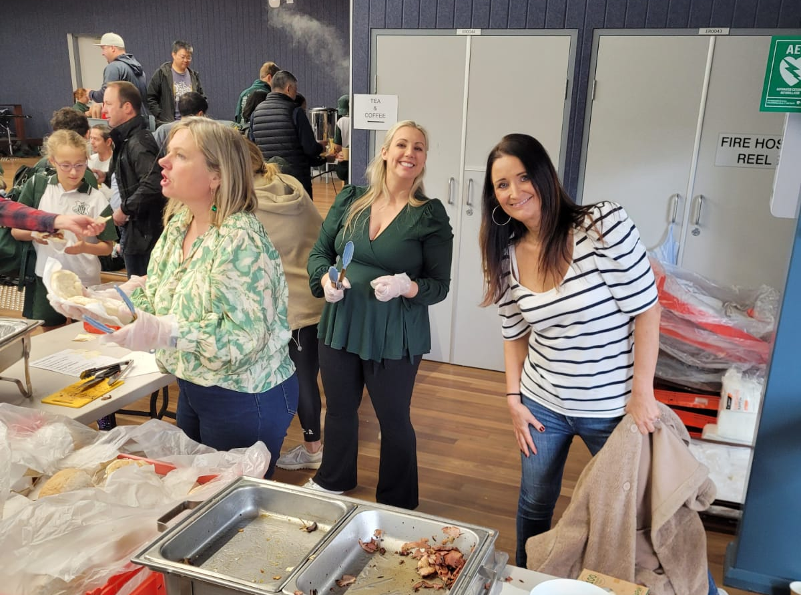
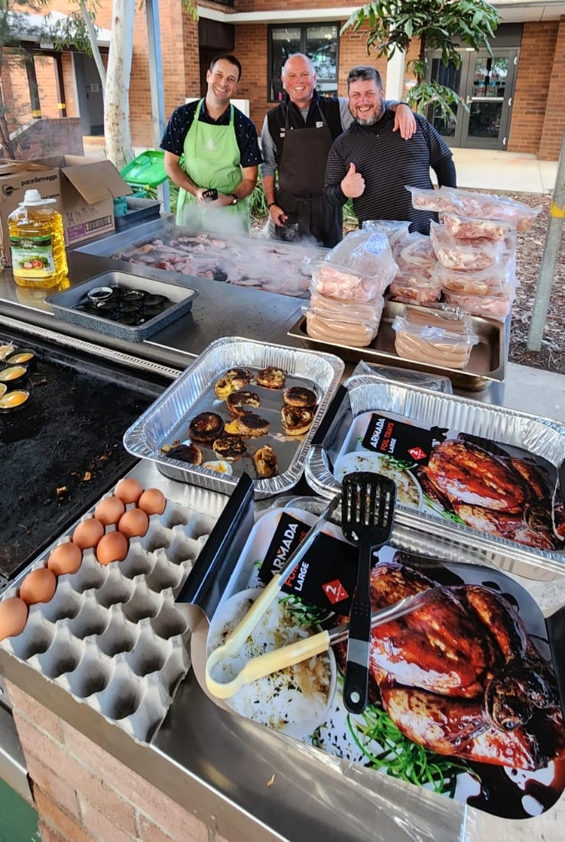
Your P&C: run by you for the kids!
MVPS P&C is managed by volunteers yet employs staff to maintain its many services to the School

Slide 4
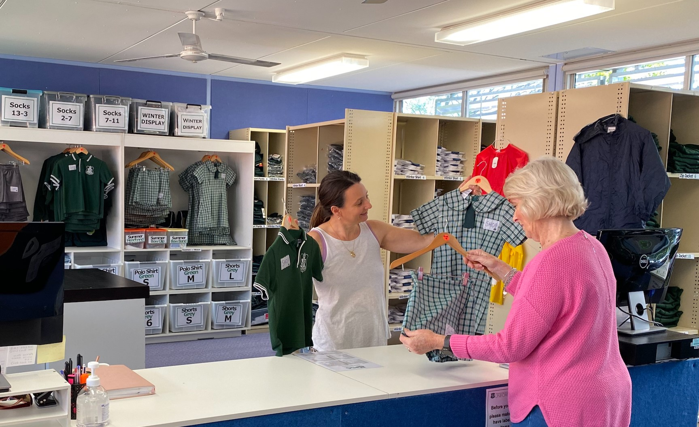
Your P&C: run by you for you!
The P&C, by means of sub-committees,
School Canteen Uniform shop
runs numerous school and social events
provides financial donations to the school to assist with procurement of various programs and resources

Slide 5
Your P&C: run by you for you!
Only 8 meetings a year
Weeks 3 & 9 each term
Pop in to 1 or come to all!

Slide 6
2023 Team
P&C Officers Bearers
Vice President/s
Emma Brown
Matthew Harris
Treasurer
Rebecca Gilfillan
Secretary
Matthew Donald
Social & Events
Nadine Kliskey
P&C Staff
Business Manager - Canteen and Uniform Shop
Karen McFadden
Canteen Staff
Danni
Cathy
Nikki
Christine
Danielle
Uniform Shop Staff
Nikki
Danni

Slide 7
2023 Team
General enquiries: info@monavalepandc.org
Volunteering for a canteen duty: canteen@monavalepandc.org
Volunteering for a uniform shop duty: uniformshop@monavalepandc.org

Slide 8
Canteen
Our on-site P&C Canteen runs 5 days a week and employs our wonderful team who creates homemade meals, hot lunches, sandwiches, sushi, salad, treats and more for our kids.
We are passionate about healthy and tasty eating for kids. We ensure that we run the “traffic light” system and meet all the NSW standards for a Healthy Eating canteen.
Canteen Volunteers
We welcome volunteers! No experience is needed!!!
If you would like to volunteer please email canteen@monavalepandc.org with your name, number and availability.

Slide 9
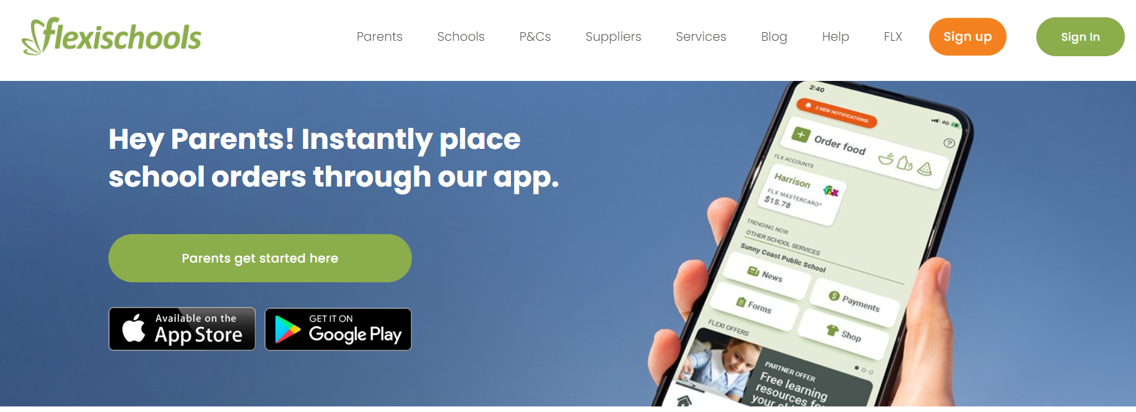
Canteen
Canteen Lunch Orders
Canteen lunch orders are made via Flexischools. Menus and ‘cut off time‘ for ordering are all detailed in Flexischools.

Slide 10
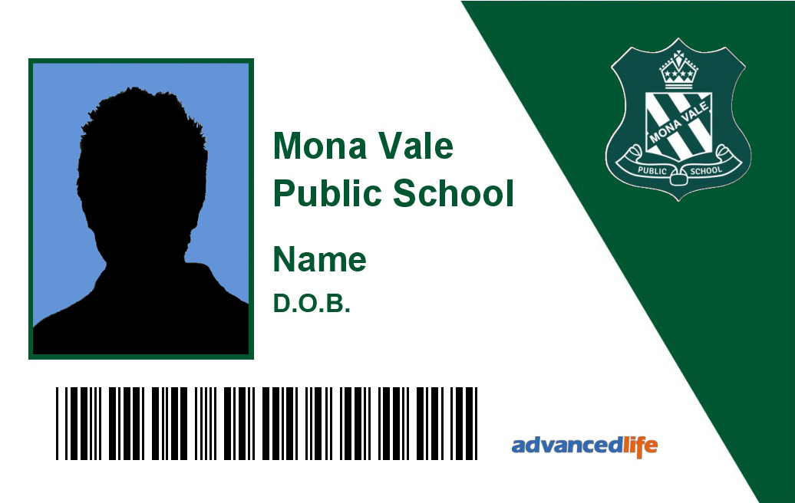
Canteen
Over the counter service
Children are provided with a canteen card when they commence School. The canteen card can be used before school for breakfast, during recess and lunch to purchase items over the counter.

Slide 11
Uniform Shop
Our P&C Uniform Shop is located onsite, we are open 2 days per week, however orders can be made at anytime online via our Flexischools app. The P&C Uniform Shop is the official supplier of the school uniforms and all profits are returned directly to the P&C to reinvest back into our children.
Uniform Shop Open times – During School Terms
Tuesday:
8:30am – 10:30am / 2.30pm – 3.15pm
Thursday:
8:30am – 10:30am
All orders placed on Flexischools are delivered to your child’s class on Tuesdays and Thursdays only.
Please note every student must have a Mona Vale Public School backpack purchased from the school uniform shop

Slide 12
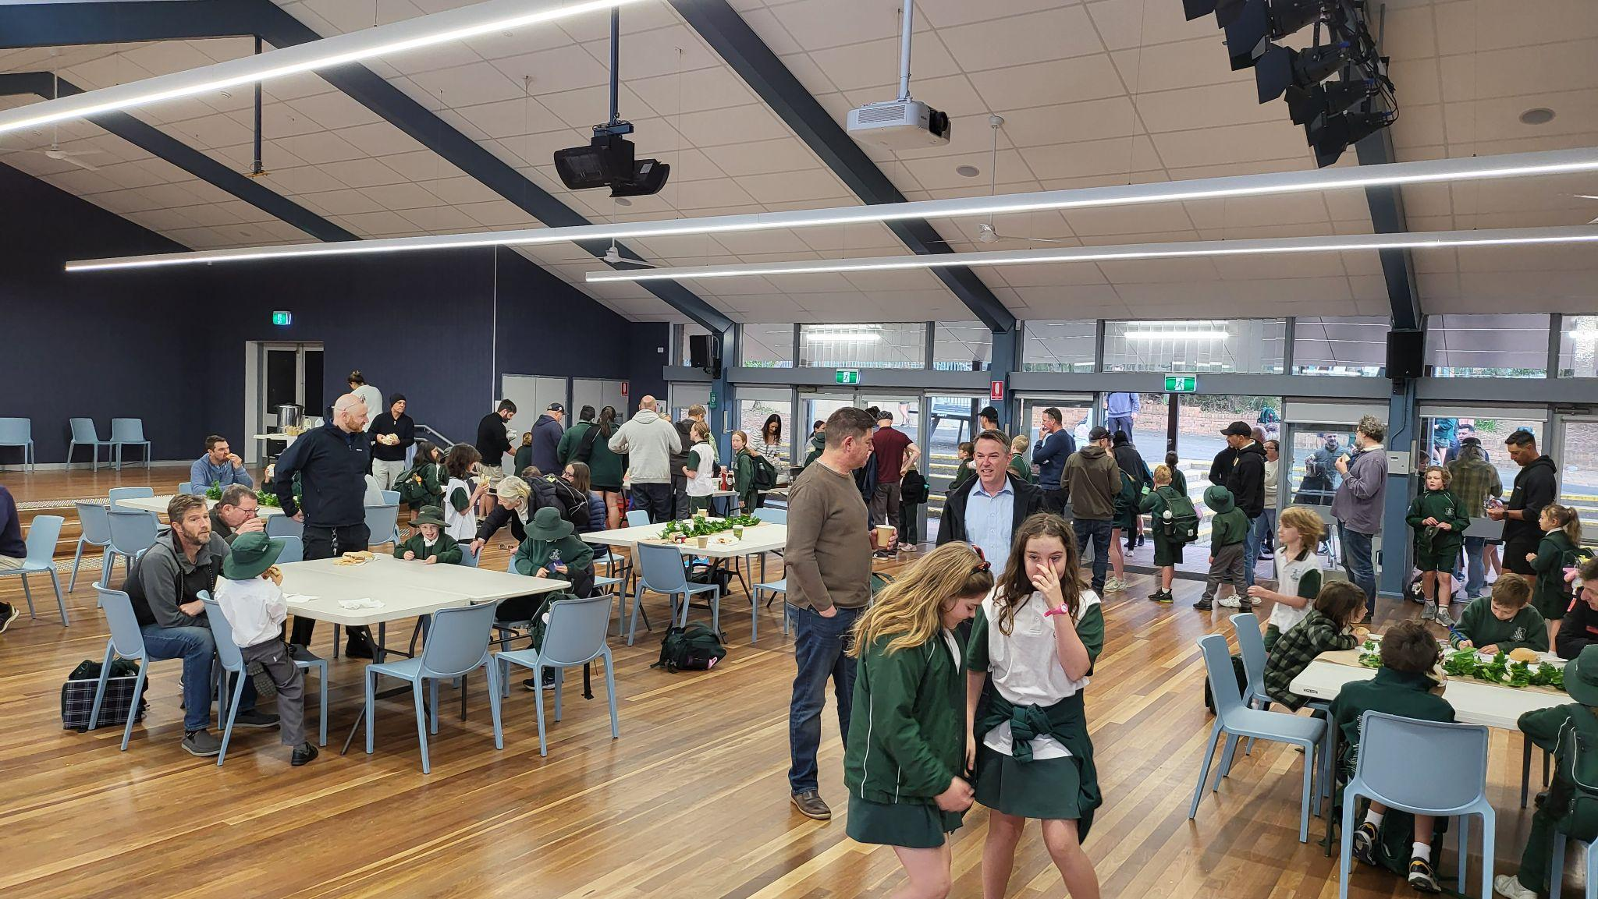
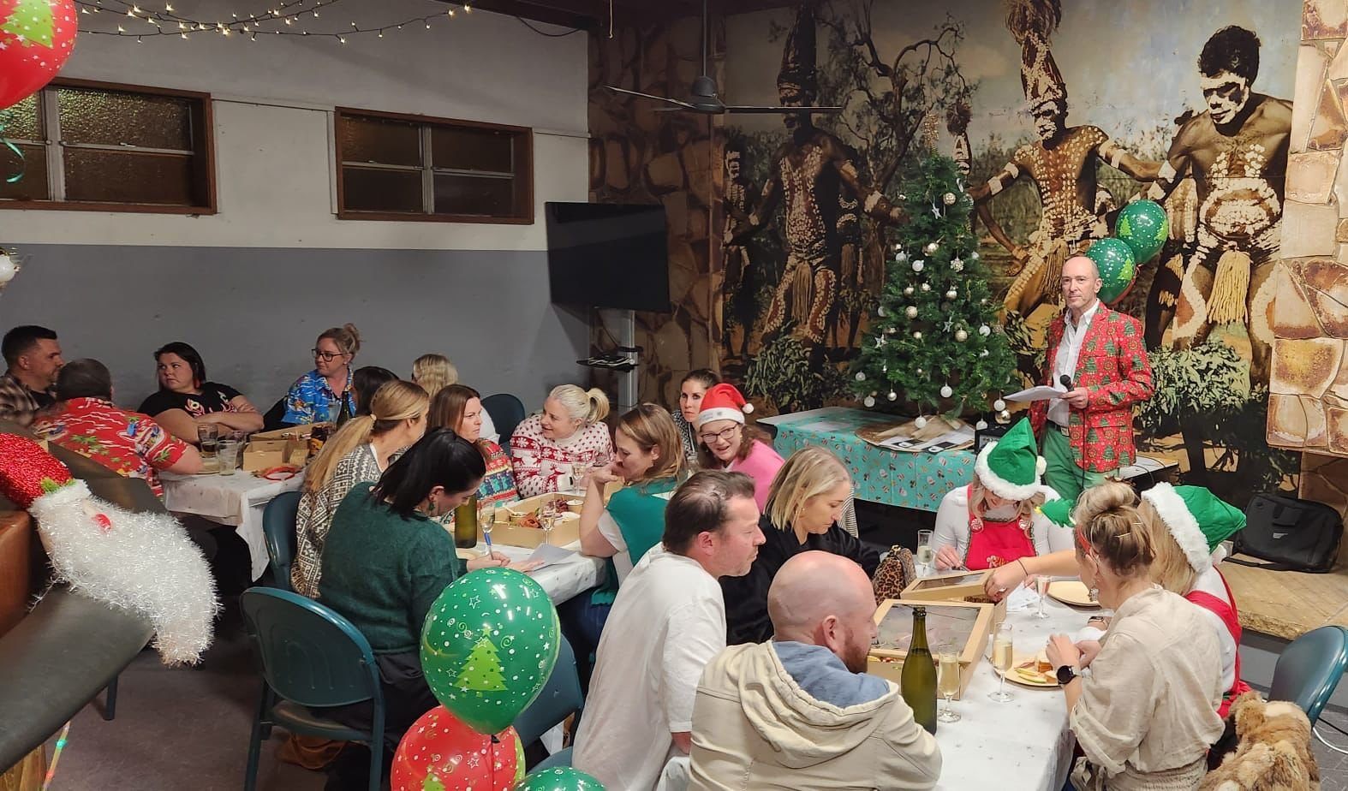
Be part of the team!
In a school of 700+ students, volunteering is not only important, it’s fun, it’s incredibly valued and valuable, it helps you meet people, your kids love it, and you are really part of a great team!
We understand everyone is busy, but WHATEVER you can do – it all helps!

Slide 13
Be part of the team!
Once a year – helping plan, or volunteer at an event
Once a term – helping on a working bee or special project
Once a month – helping at the canteen, uniform shop or in the classroom
Once a week – helping on the P&C or in the classroom
Think about what skills you have - accounts, creative, food, retail, sports, events, logistics, building, bbq expert, musical, or just have some free time! Think how you could bring your expertise to the school.
The more of us that pull together, the more fun and easier it is.
You can be part of the P&C, help in the Canteen or Uniform Shop, volunteer an hour at an event, use your skills to help around the school, or just attend P&C meetings so you know what’s happening and be part of the decision process.

Slide 14
Financial Contributions
P&C Funds
The P&C ensures funds are distributed across all areas of the school, that ideally impacts and benefits the a broad cross-section of students, supports all teaching areas of the school, and maintains and improves facilities and education offerings with the school.
There are limited ways the P&C can raise funds….please support the events and make your contribution

Slide 15
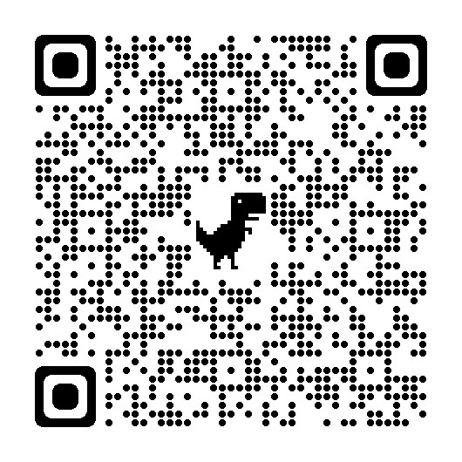
We welcome you to the MVPS family and hope to see you soon
info@monavalepandc.org

