Slide 1
Mona Vale Public School
2024 School Year

Slide 2
We are grateful to be able to show our respect to the Traditional People of this land, the Elders past, present and upcoming. We are honoured to be able to learn and play on this land surrounded by the ocean, bushland and the waterways of Pittwater. Our hope for the future is for a better understanding of our local history and culture.
Acknowledgement of Country

Slide 3
Our School Values

Slide 4
Line of Communication
Please always contact your class teacher with any questions or concerns. Your child’s class teacher should always be contacted prior to contacting the Assistant Principal, Deputy Principals or Principal.
CLASS TEACHER
ASSISTANT PRINCIPAL
DEPUTY PRINCIPAL
PRINCIPAL
01
02
03
04

Slide 5
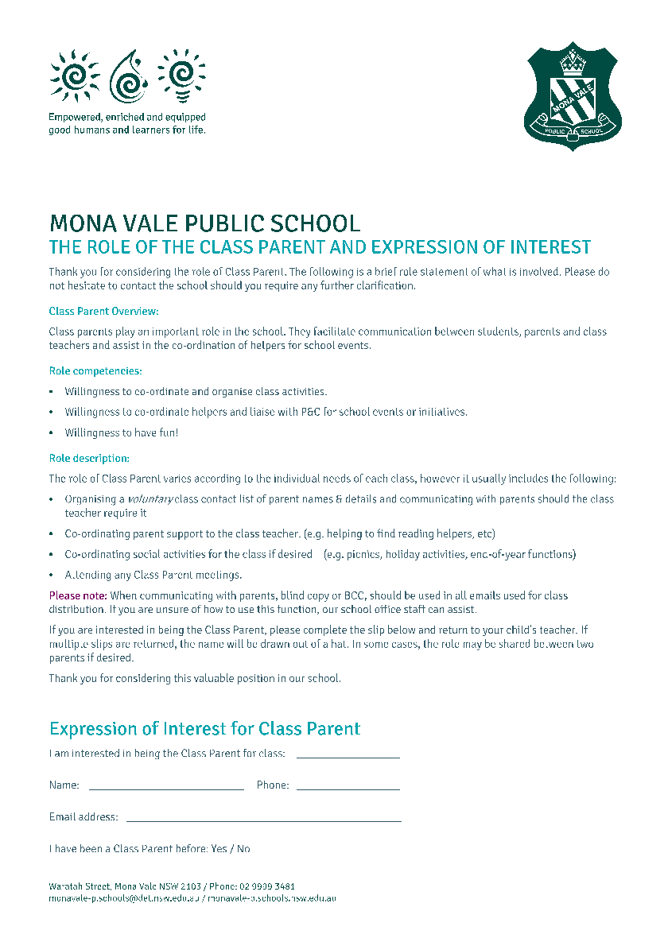
Voluntary Parent Contact Information & Class Parent
Please complete the voluntary parent contact form and class parent nomination form available here today. These will also be placed on the school website.
The voluntary parent contact information form will be provided to the class parent.
Role of the Class Parent: Class parents play an important role in the school. They facilitate communication between parents and class teachers and assist in the coordination of helpers for school events. Please see the handout in your Meet the Teacher pack for more detail.

Slide 6
Student Absences
If your child is arriving to school late, or being collected early, please provide a written note or send an email to your class teacher.
Late arrivals: any child arriving after 8:50am will need to arrive at the main Waratah street gate (with a parent). Please use the intercom to contact the office to let them know of your child's arrival.
Early departure: If you need to collect your child early, please contact your class teacher or the school office prior to arriving to collect your child. Your child will need to go to the office to sign out. Please arrive at the main Waratah gate and use the intercom to let the office know you have arrived. A staff member will walk your child to the gate to meet you.
Absences: If your child is unwell or absent from school, please respond to the SMS message you receive on their first day of absence. If your child is likely to miss more than one day of school, indicate this in the text or email the class teacher.
If your child is absent for more than 2 consecutive days and we have not heard from a parent or family member, the class teacher will contact you.

Slide 7
Please be mindful of late arrivals - 10-15 minutes lateness everyday adds up over a school term.

Slide 8
Communication
MVPS NEWSLETTER
FLEXISCHOOLS APP
Our school newsletter is published fortnightly (even weeks) and sent out via the app.
Don’t forget to download the Flexischools app to receive important school notifications. If you already have the app, please also remember to update your child’s class this year.
The uniform shop is open at the following times:
Tuesday - 8.30-10.30am/2.30-3.15pm
Thursday - 8.30-10.30am
Supplies from the uniform shop can also be ordered through the Flexischools app. This will then be delivered straight to your child's classroom.
The P&C Facebook page is the officially endorsed social media platform for the parent community. Administered by volunteers, it is endeavoured to be updated with any new information.
Mona Vale Public School Website: https://monavale-p.schools.nsw.gov.au/

Slide 9
School Bytes

Slide 10
In the morning
Now that all classroom renovations have been completed, students will be going back to their original bag drop areas.
All students must then head to the K-2 Cola with their hats on. We ask that all parents leave the school grounds at this time so that the children can engage in some play before bell time. The playground is fully supervised from 8:20am.
Students will line up in their class lines for a quick morning assembly with the K-2 teachers. It is advantageous for the students to have no parents waiting around at this time.
Students are then taken to collect their bags, walk into the bag rooms to independently unpack their things. We request that you practise this daily with your child. Have them pack their bags in the morning and unpack their own bags in the afternoon.
The more you do for them, the less they can do for themselves. Independence leads to improved self management skills and confidence.
Meet the teacher 2024

Slide 11
Food Breaks at School
We have a 3 food breaks at school.
Every morning at approximately 10:00am we have a short break that we call crunch and sip or fruit break. Please send a SMALL piece of cut up, fresh fruit or vegetable in a separate container
Recess - This is a 30-minute break when the students go out for something to eat and play.
Lunch - This starts with 10 minutes of eating time out in the playground and then the students are given 30 minutes to go outside and play.
IMPORTANT - Please have their crunch and sip, recess and lunch in separate bags/containers and clearly labelled. Bento boxes are quite confusing and hard to manage for the students.
Meet the teacher 2024

Slide 12
Canteen - Recess and Lunch orders
Students will be allowed to go to the canteen at recess, once they have been issued with their ‘canteen card’. We are currently awaiting a time frame on this for the Kindergarten students.
Lunch orders are available and the Kindergarten students will be collecting these from the canteen from Week 5.
They are currently being delivered by Year 6 students.
If you are volunteering at the canteen, we will attempt to have your child collect the lunches. They usually tell us when you are on the canteen.

Slide 13
Kindergarten routines
Odd weeks 1, 3, 5, 7, 9, 11
MONDAY | TUESDAY | WEDNESDAY | THURSDAY | FRIDAY
 |  | PDHPE (sports uniform) Music | Grade Sport (sports uniform)
Even weeks 2, 4, 6, 8, 10
MONDAY | TUESDAY | WEDNESDAY | THURSDAY | FRIDAY
Library |  | PDHPE (sports uniform) Music | Grade Sport (sports uniform)
Library is every fortnight- please return the books/bags so that your child can borrow.

Slide 14
Important events
Event/s
Excursion/Incursion | These will be added as the year progresses
Class Parent Induction & Afternoon Tea | Wednesday 13th March
Parent Interviews | Monday 18th March - Thursday 22nd March
Easter Hat Parade | Thursday 28th March
Honour Assembly | Friday 5th April

Slide 15
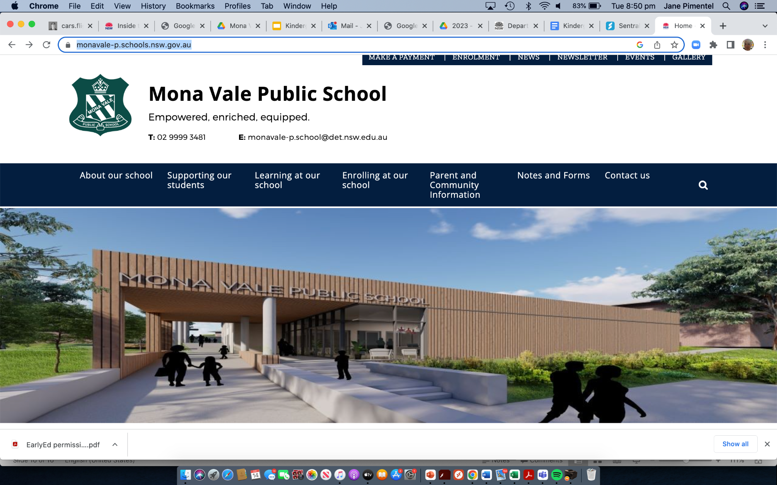
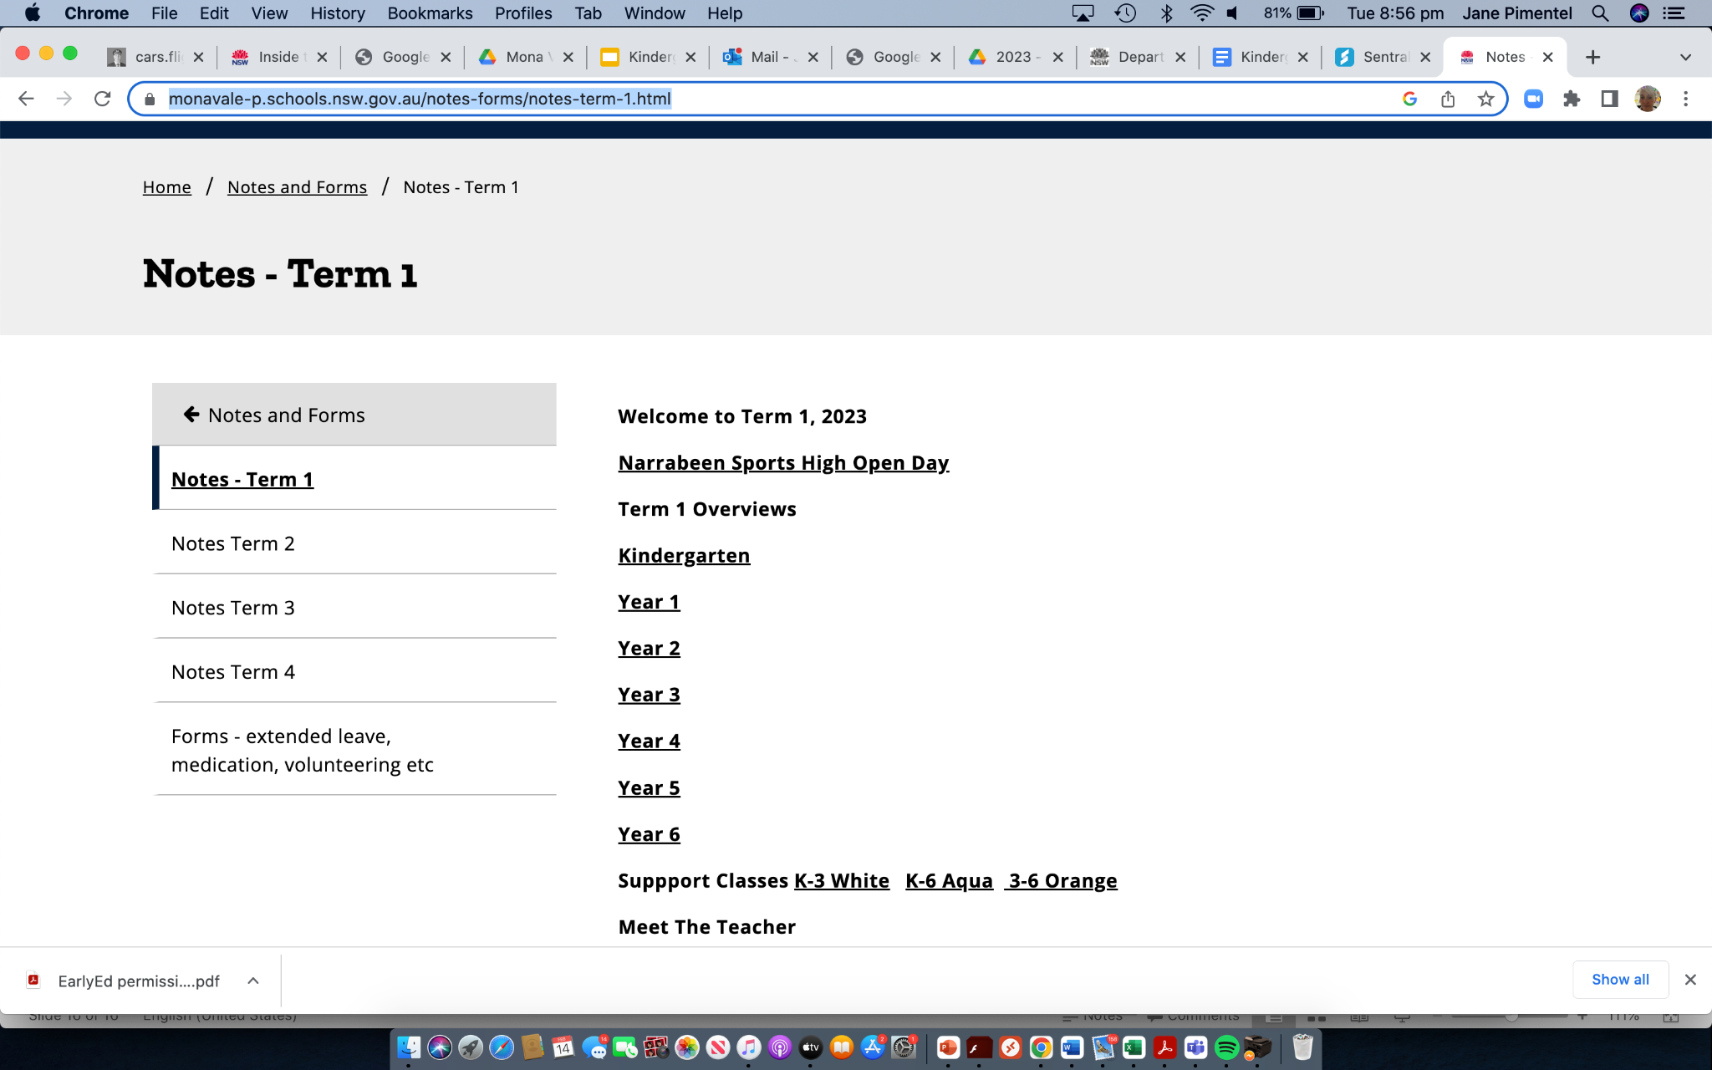
Term overview
The Kindergarten term overview can be found on the school website.
Look for the notes and forms tab
and select Term 1.

Slide 16
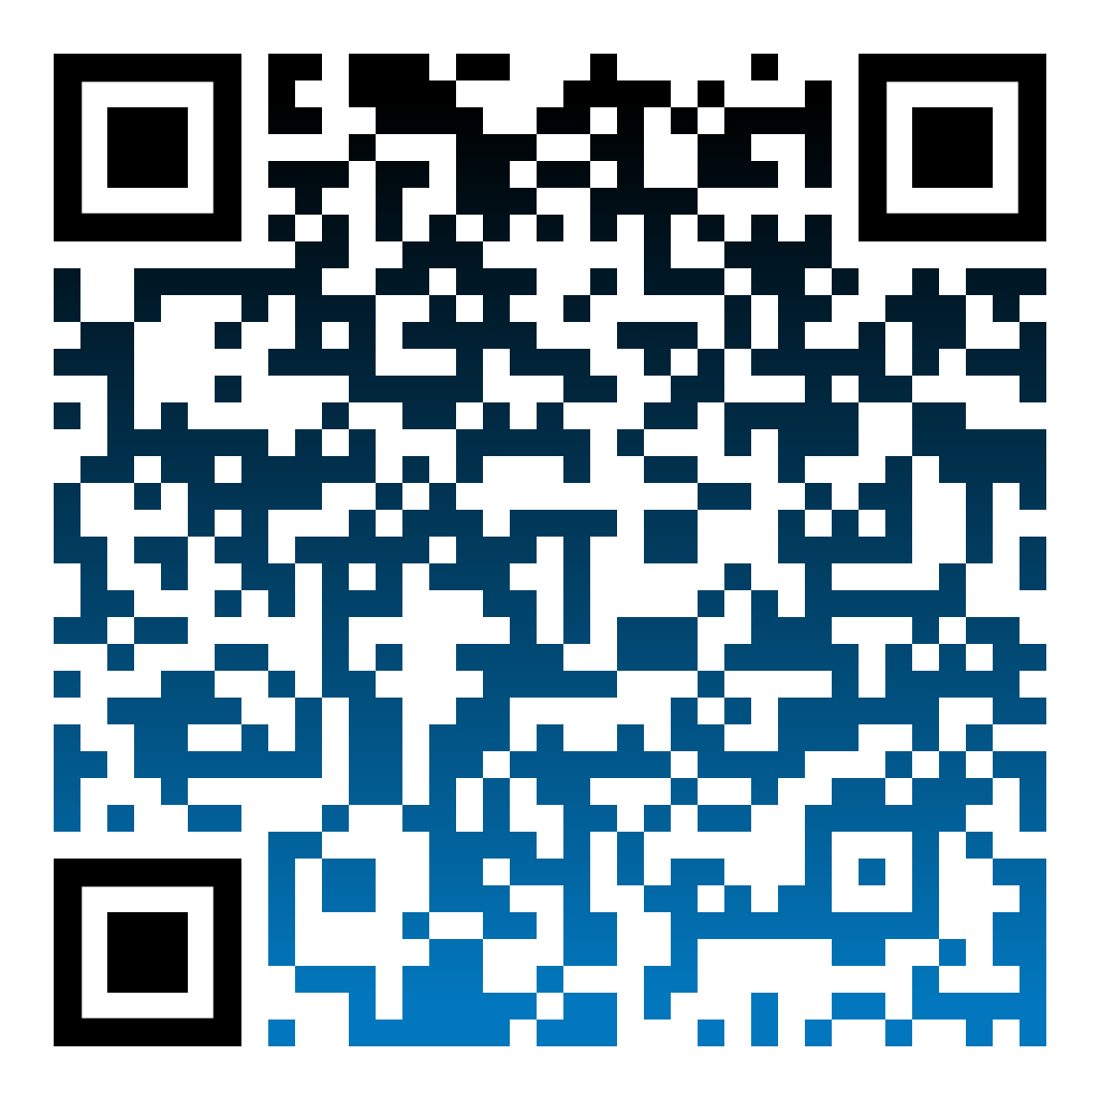
NEW CURRICULUM K-6
The new curriculum, gives students more time to focus on key learning areas so that they can acquire a deeper understanding of central concepts. It will ensure students develop strong foundations for learning, life and work.
The new curriculum is underpinned by extensive research and encompasses many aspects of schooling, including teaching, learning, assessment and reporting to parents. Some key curriculum changes include:
Building strong foundations for future learning with new English and Mathematics syllabuses
The new syllabuses focus on what is essential to know and do in early and middle years of schooling, and key learning areas in the senior years
Providing more time for teaching by reducing the hours teachers spend on extra-curricular topics and issues and compliance requirements
For more information and/or queries around the new curriculum and its implementation at MVPS contact our Assistant Principal, Curriculum & Instruction:
Elise Milotic (elise.milotic@det.nsw.edu.au) Erin Jones (erin.jones2@det.nsw.edu.au).
For more information on how you can support your child at home in regards to the new curriculum scan the QR code.

Slide 17
Home learning (to begin in week 5)
Reading - Students will be given 2 books for the week - It is important to read each book multiple times. This builds fluency and accuracy.
Magic Days - Students are allocated one day each week where they will bring in their home reading folder and present their news.
Free choice news will be allocated this term. Term 2-4 will have a free choice component and a curriculum focus on alternating weeks. This will be advised at the start of each term.

Slide 18
Kindergarten will be focusing on READING at home this term using home readers.
Our home readers are decodables and have sounds, tricky words and comprehension questions in every book.
Please have your child read the sounds, words and tricky words at the front of each book prior to reading.
The comprehension questions are found at the back of the book. After reading, please have your child answer the questions to check their understanding.
Re-reading home readers throughout the week increases fluency when reading.
*School policy for Kindergarten is home learning should not take more than 10-15 minutes each night inc. reading. Home learning is optional.
Meet the teacher 2024

Slide 19
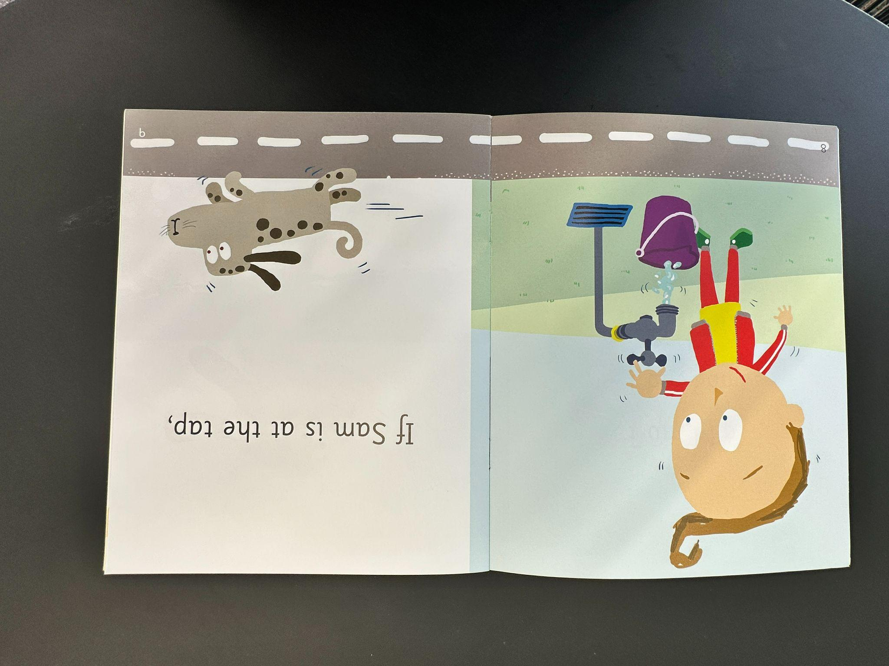
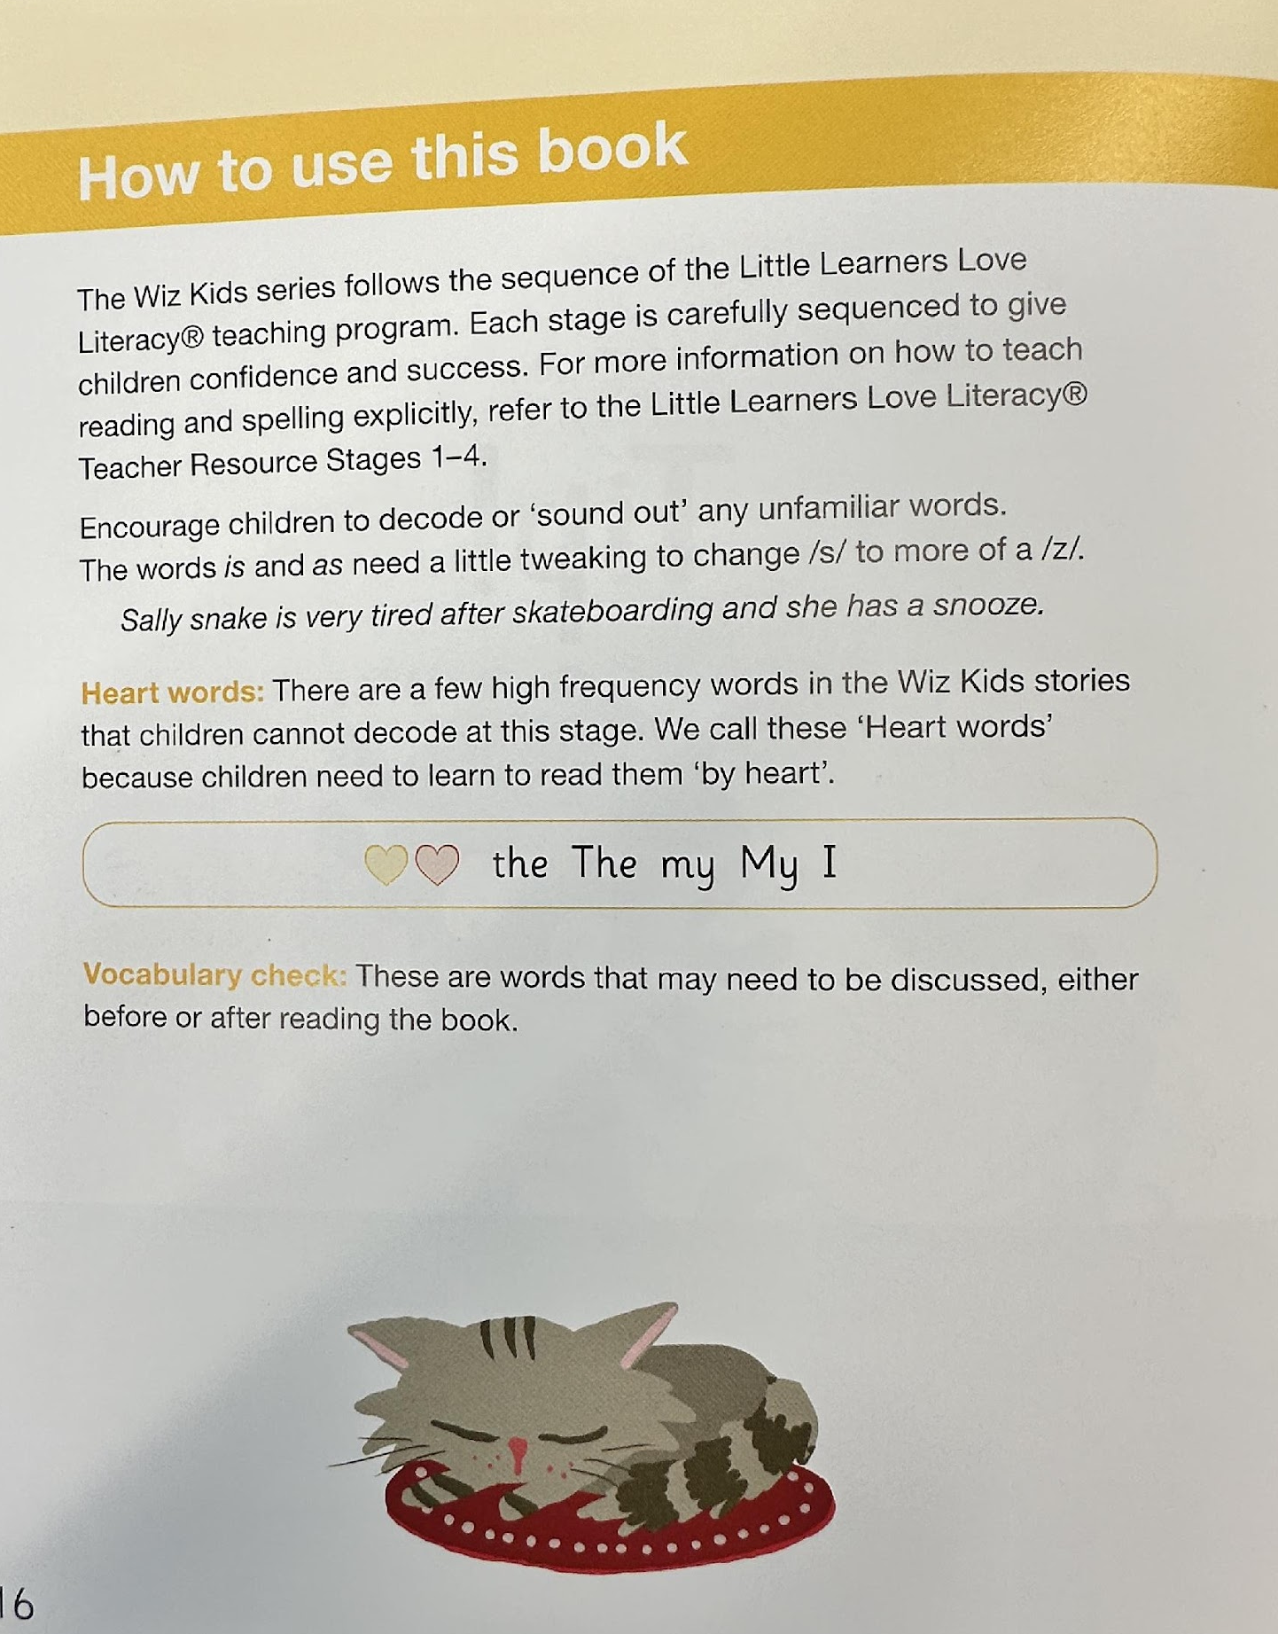
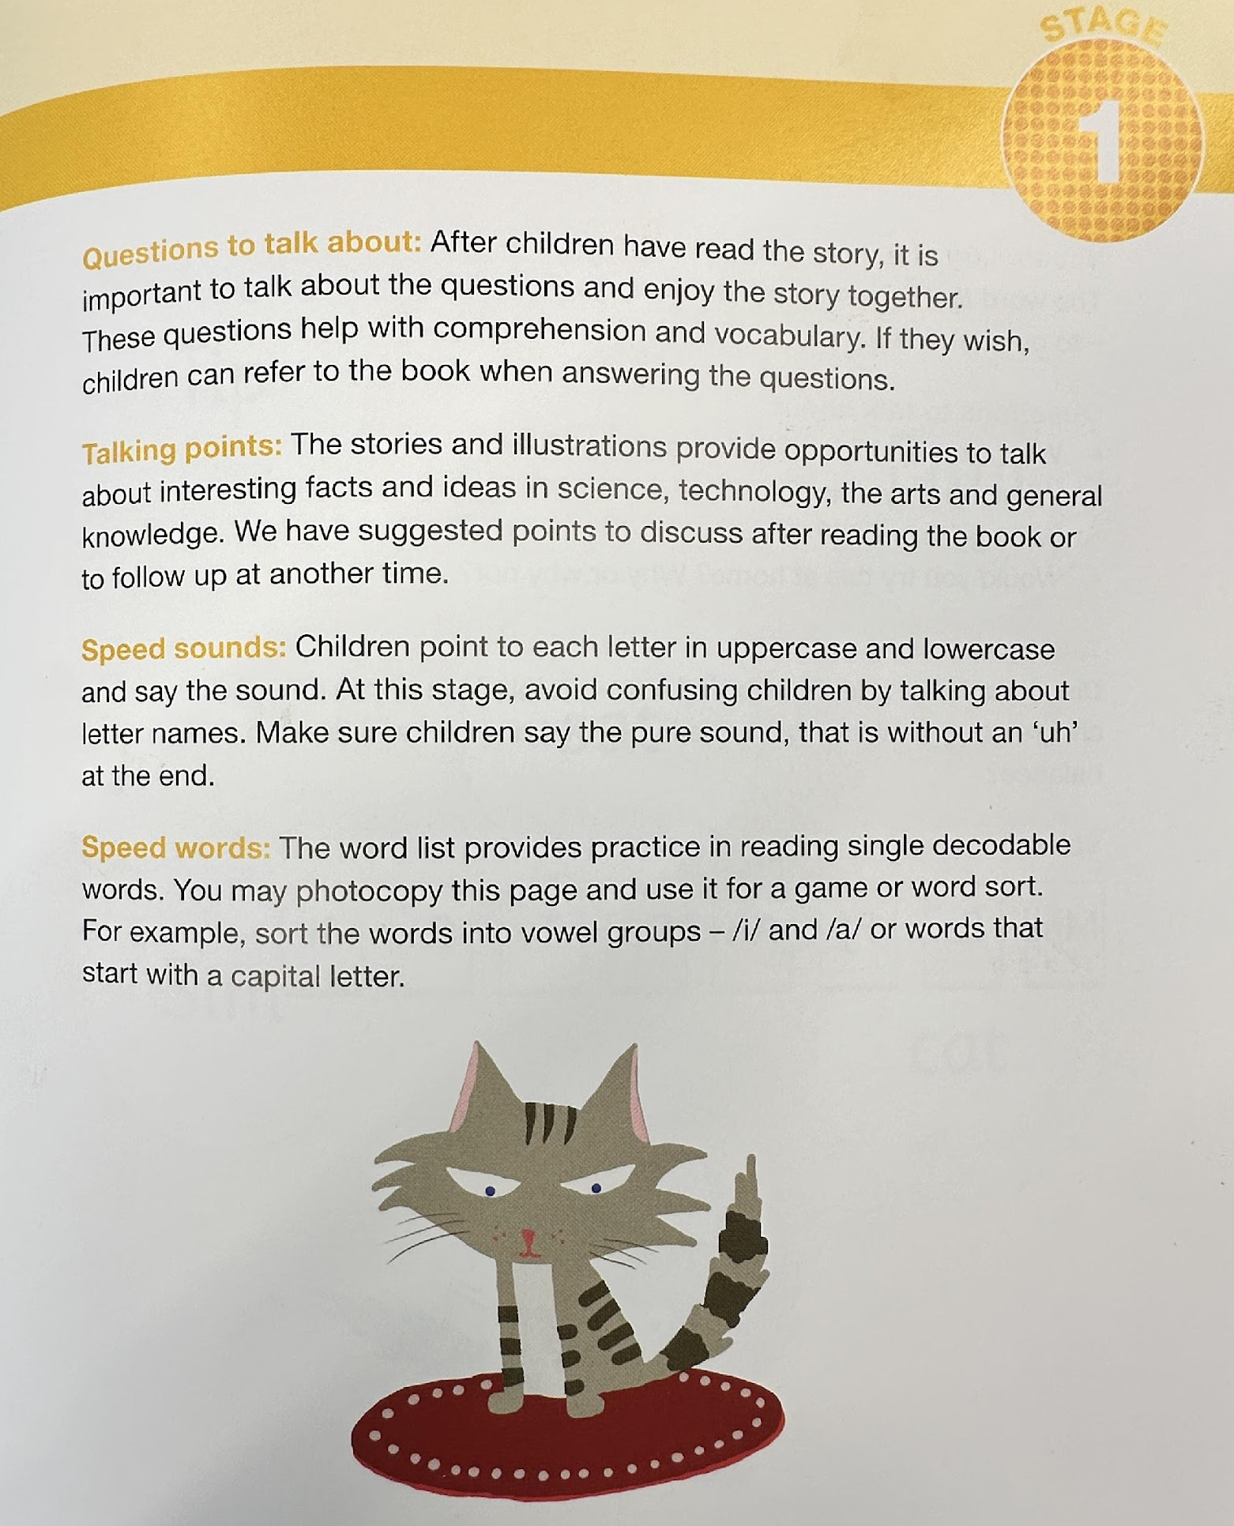
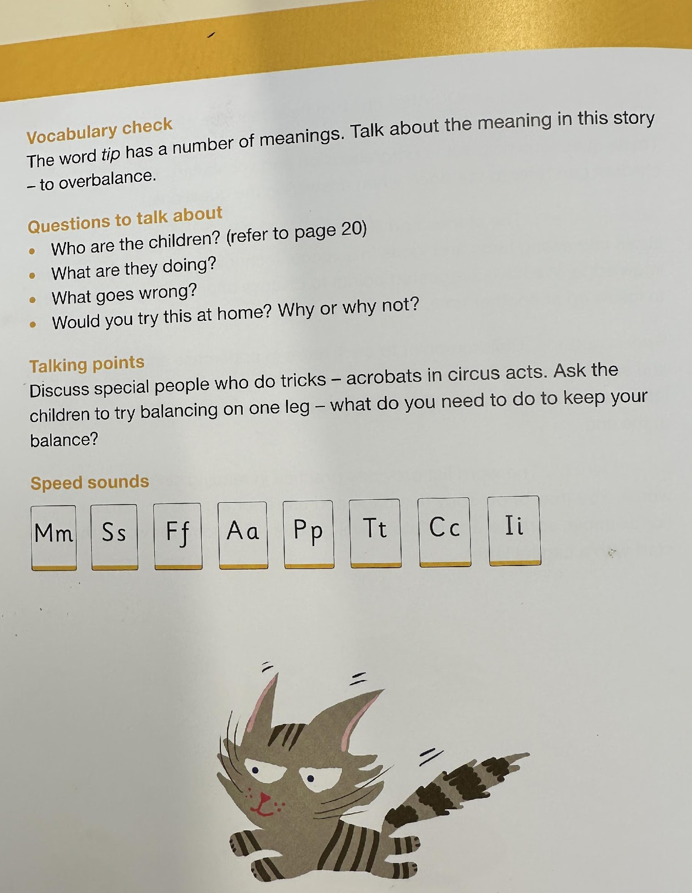
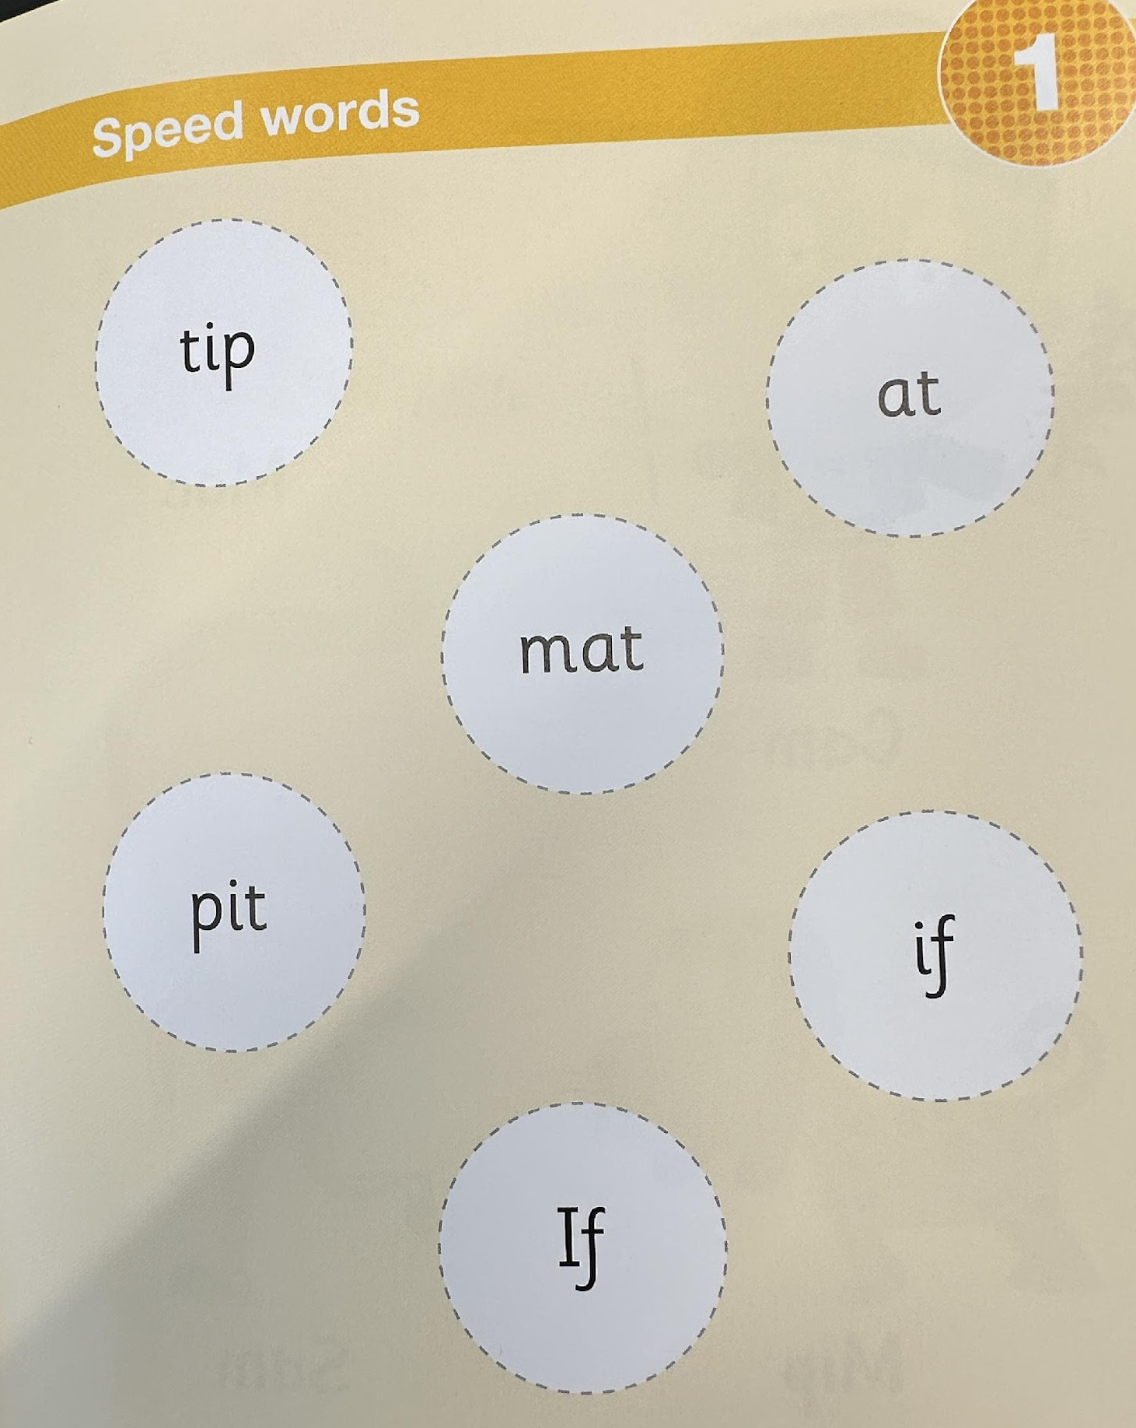
Reading at home - navigating the books

Slide 20
Heart Words
The students will be given ‘heart words’ for the term.
These are the words that they see regularly in the books that they are reading, both at home and at school.
You can go through these words to help your child understand and recognise these words in context.
When you have completed the reading of the words, go back and practise spelling them. There is a small book in your child’s home learning folder for them to use.
These sheets are for you to progress through, at your own pace.
You will be given a new set of words at the beginning of each term.
Meet the teacher 2024

Slide 21
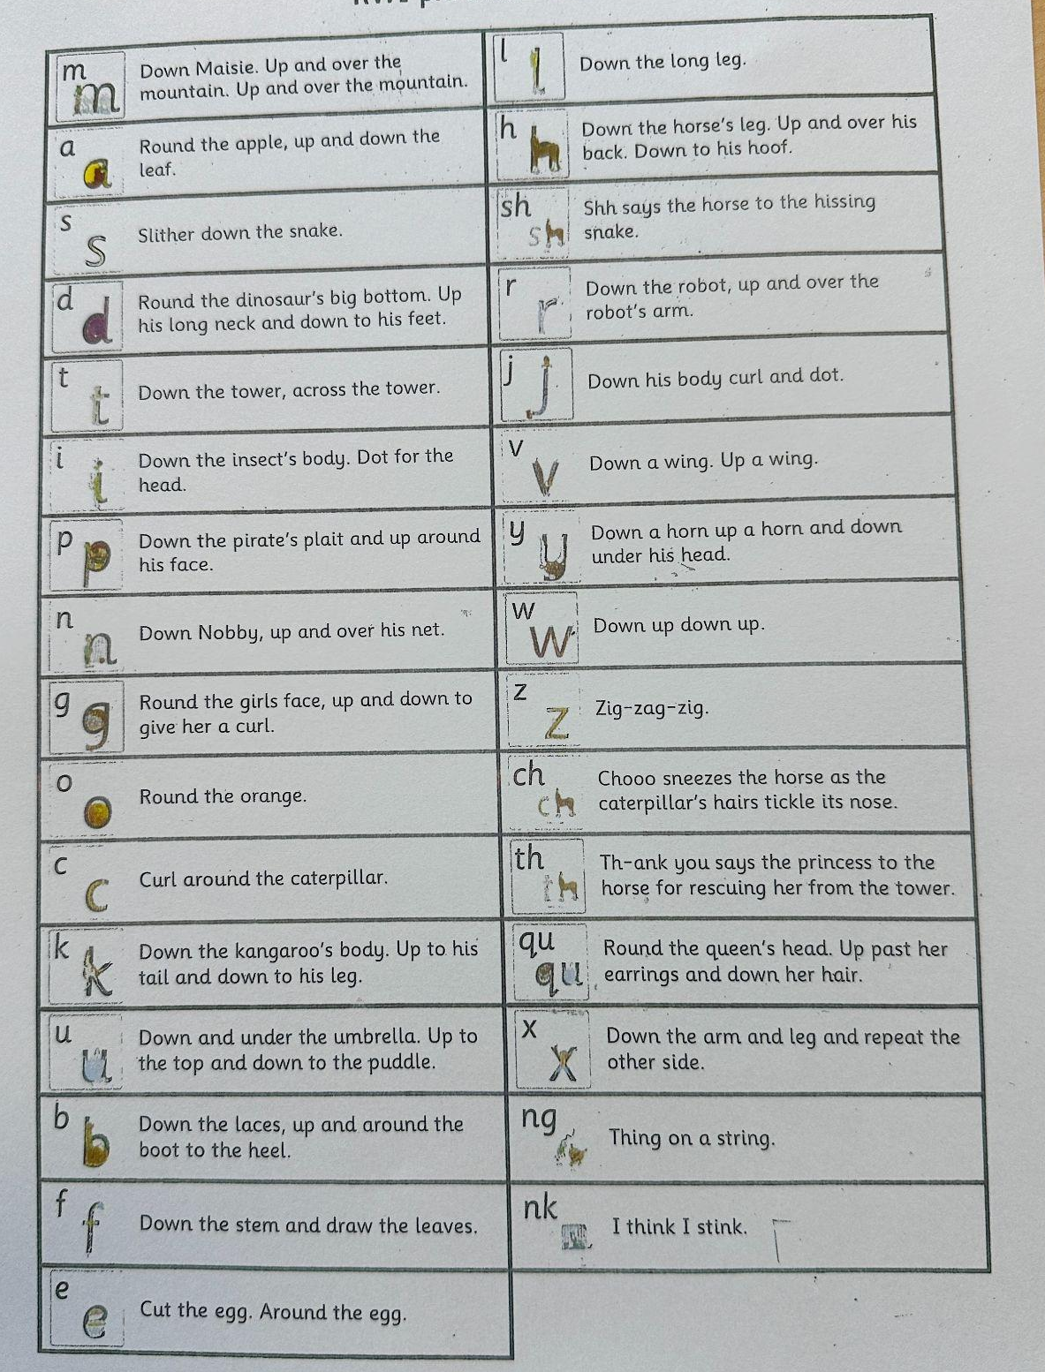
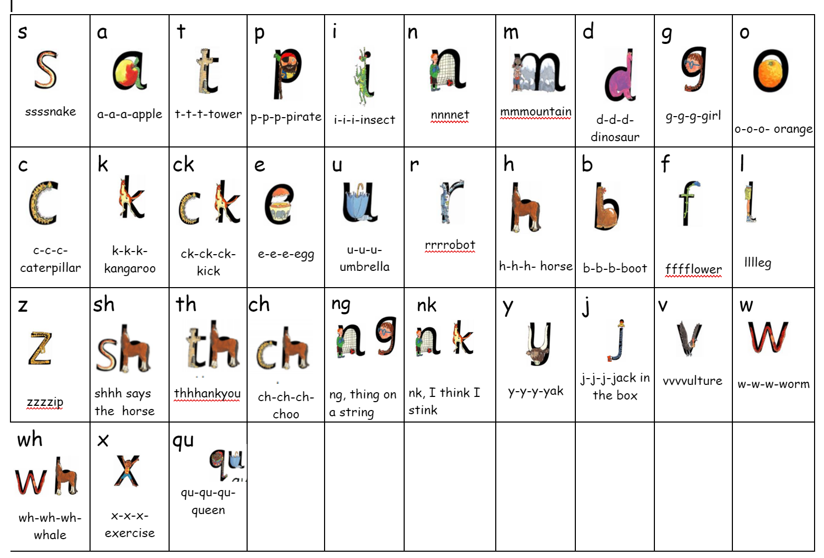
Phonics Progression / Handwriting rhymes
Meet the teacher 2024

Slide 22
Numeracy
NUMBERS – they are everywhere and in everything we do. - Make numbers fun, playful and relevant
-Play board games – dominoes, dice games, snakes and ladders, uno, card games
Look for lots of incidental learning
Number sense is not taught…… it’s caught!
- Simple counting forwards and backwards
- Identifying numerals 1-20 and counting out corresponding objects
- Matching objects that are similar shape, size or colour.
- Making patterns, exploring shapes etc
Goal – to have a flexible understanding of numbers
and the relationship between them
Keep using the Write and Wipe pockets from transition packs
Meet the teacher 2024

Slide 23
Curriculum subjects
English and Mathematics take up 50% of the weekly lessons.
Students will also be engaged in:
History and Geography
Science - Physical World, Material World, Living World, Earth and Space, Digital Technologies.
Visual Art, Drama, Dance, Music
PDHPE and Child Protection
Meet the teacher 2024

Slide 24
In-Class Support
This year, the Kindergarten teaching team would like to invite parents and carers into our classrooms. This will be to assist with student learning with a focus on reading. Once the class parents have been assigned, more information will be sent home. We look forward to having you in our classrooms soon.
Meet the teacher 2024

Slide 25
Social emotional learning (SEL)
Friendology and U R Strong (Term 1)

Slide 26
Social emotional learning (SEL)
Bounce back (Term 2-4)

Slide 27
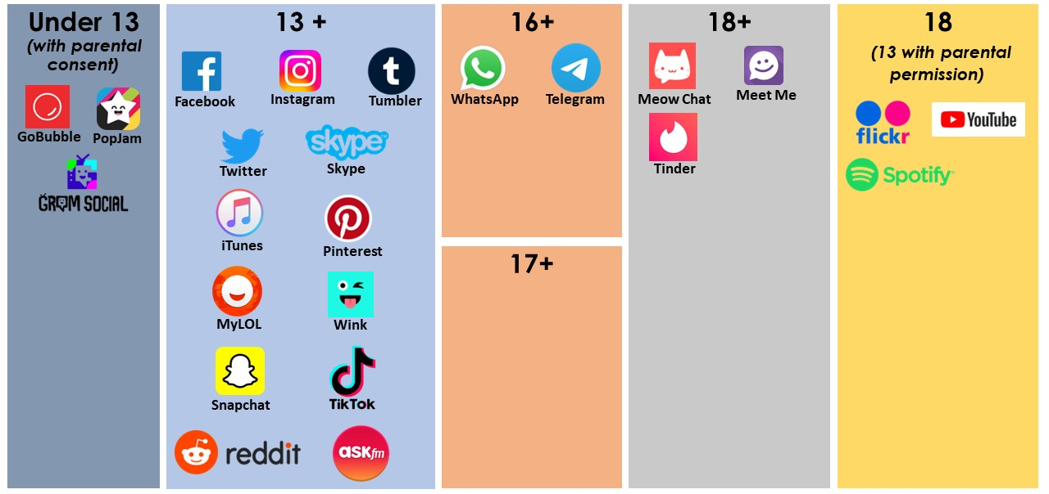
Social Media Age Restrictions - Just a reminder

Slide 28
Thank you for attending our Meet the Teacher Evening!

