Slide 1
Mona Vale Public School
2024 School Year

Slide 2
We are grateful to be able to show our respect to the Traditional People of this land, the Elders past, present and upcoming. We are honoured to be able to learn and play on this land surrounded by the ocean, bushland and the waterways of Pittwater. Our hope for the future is for a better understanding of our local history and culture.
Acknowledgement of Country
Acknowledgement of Country
We are grateful to be able to show our respect to the Traditional People of this land, the Elders past, present and upcoming. We are honoured to be able to learn and play on this land surrounded by the ocean, bushland and the waterways of Pittwater. Our hope for the future is for a better understanding of our local history and culture.

Slide 3
Year 4 Classes and teachers
Grade leader | Miss Jess Brilman
Class | Teacher
4 Blue | Miss Abbey Eyre
4 Lime | Miss Bethany Whittington
4 Orange | Mrs Tara Sheppard
4 Purple | Mr Lachlan Stewart

Slide 4
Line of Communication
Please always contact your class teacher with any questions or concerns about your child. Class teachers should always be contacted prior to contacting the Assistant Principal, Deputy Principals or Principal.
CLASS TEACHER
ASSISTANT PRINCIPAL
DEPUTY PRINCIPAL
PRINCIPAL
01
02
03
04

Slide 5
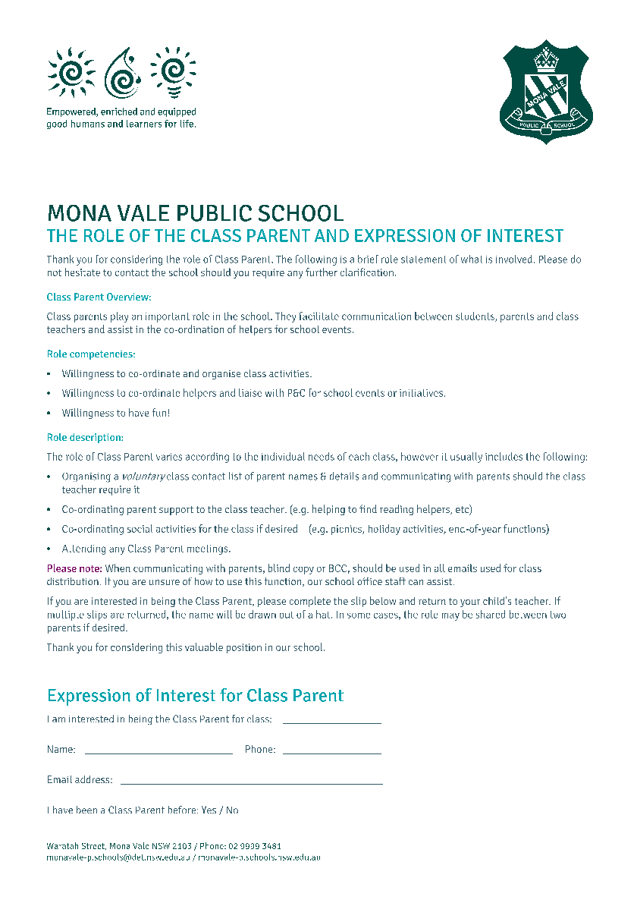
Voluntary Parent Contact Information & Class Parent
Please complete the voluntary parent contact form and class parent nomination form available here today. These will also be placed on the school website.
The voluntary parent contact information form will be provided to the class parent.
Role of the Class Parent: Class parents play an important role in the school. They facilitate communication between parents and class teachers and assist in the coordination of helpers for school events. Please see the handout in your Meet the Teacher pack for more detail.

Slide 6
Student Absences
If your child is arriving to school late, or being collected early, please provide a written note or send an email to your class teacher.
Late arrivals: any child arriving after 8:50am will need to arrive at the main Waratah street gate (with a parent). Please use the intercom to contact the office to let them know of your child's arrival.
Early departure: If you need to collect your child early, please contact your class teacher or the school office prior to arriving to collect your child. Your child will need to go to the office to sign out. Please arrive at the main Waratah gate and use the intercom to let the office know you have arrived. A staff member will walk your child to the gate to meet you.
Absences: If your child is unwell or absent from school, please respond to the SMS message you receive on their first day of absence. If your child is likely to miss more than one day of school, indicate this in the text, email or letter the class teacher.
If your child is absent for more than 2 consecutive days and we have not heard from a parent or family member, the class teacher will contact you.

Slide 7
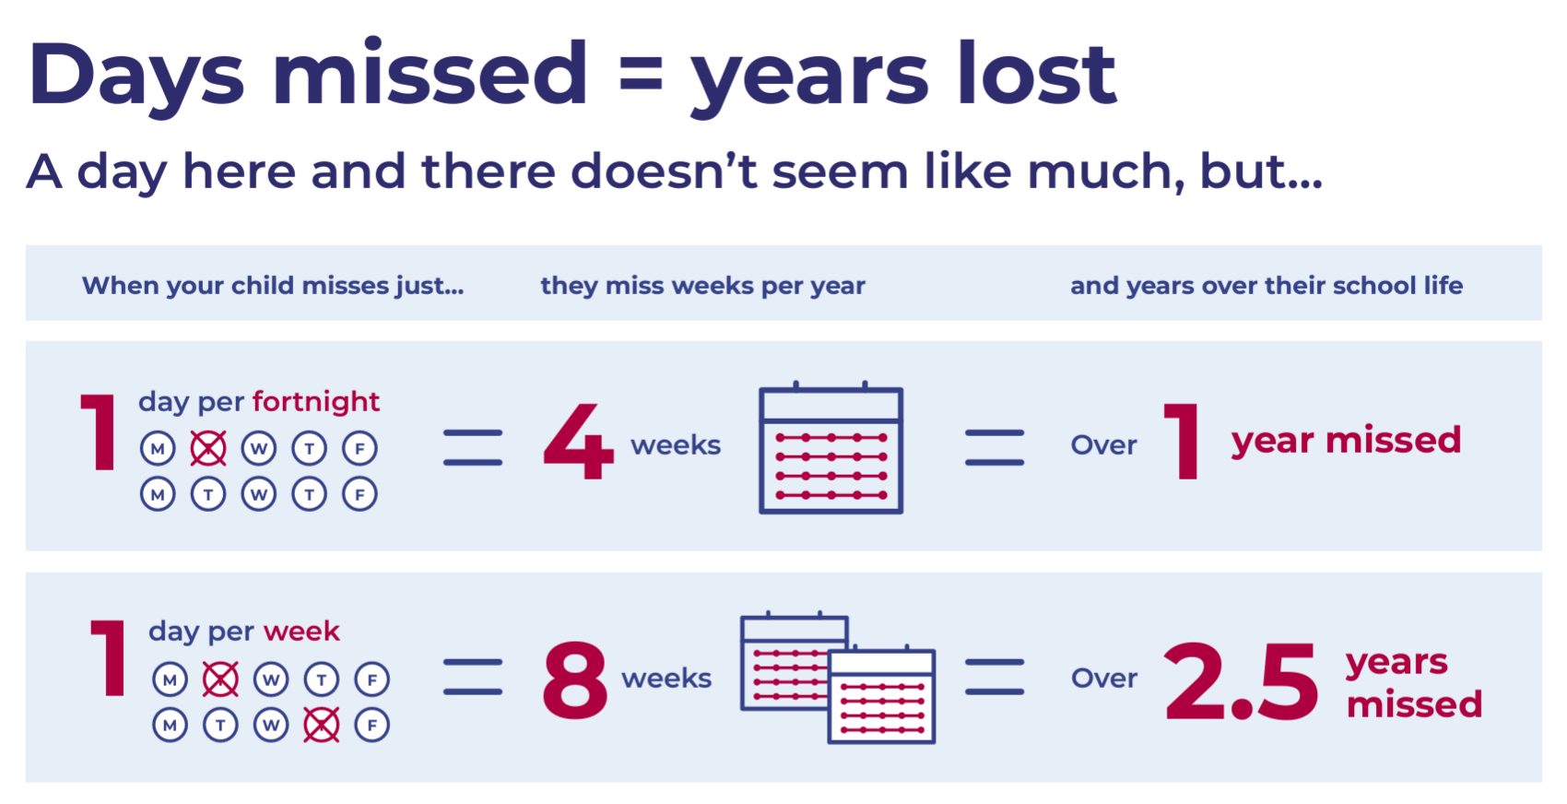
Attendance
Regular attendance at school is essential for students to achieve quality life outcomes. Schools, in partnership with parents, are responsible for promoting the regular attendance of students.
If you are planning a holiday and will be away for 10 school days please download the holiday exemption form from our website.

Slide 8
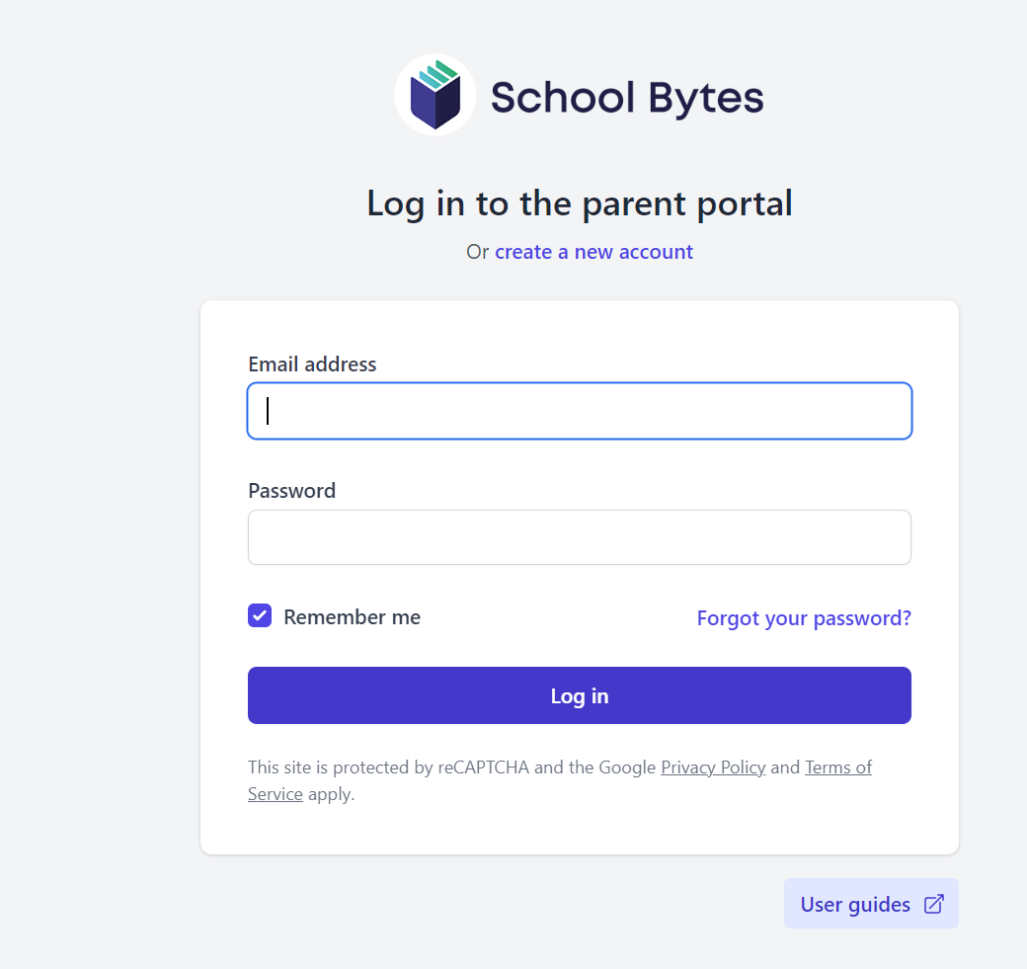
Communication
MVPS NEWSLETTER
FLEXISCHOOLS APP
Our school newsletter is published fortnightly (even weeks) and sent out via the app.
Don’t forget to download the Flexischools app to receive important school notifications. If you already have the app, please also remember to update your child’s class this year.
The P&C Facebook page is the officially endorsed social media platform for the parent community. Administered by volunteers, it is endeavoured to be updated with any new information.
MVPS SCHOOL BYTES
We use School Bytes to send out permission and payment information for excursions etc. Please download the parent portal.
Mona Vale Public School Website: https://monavale-p.schools.nsw.gov.au/

Slide 9
Year 4 routines
Odd weeks 1, 3, 5, 7, 9, 11
MONDAY | TUESDAY | WEDNESDAY | THURSDAY | FRIDAY
Science | PE, Health, Music & Drama | Scripture |  | School Sport and PPSSA
Even weeks 2, 4, 6, 8, 10
MONDAY | TUESDAY | WEDNESDAY | THURSDAY | FRIDAY
Science | PE, Health, Music & Drama | Scripture | Library | School Sport and PPSSA
Library is every fortnight- please return the books/bags so that your child can borrow.

Slide 10
Important events
Event/s | Links to learning
PSSA Commences | Week 5 - Friday 1st March
Parent Interviews | Monday 18th of March - Friday 22nd of March (Week 8)
OC Test | Applications open end of Term 1 - We will hold an OC open night.
Cross Country | Term 2 Week 1- Thursday 2nd May

Slide 11
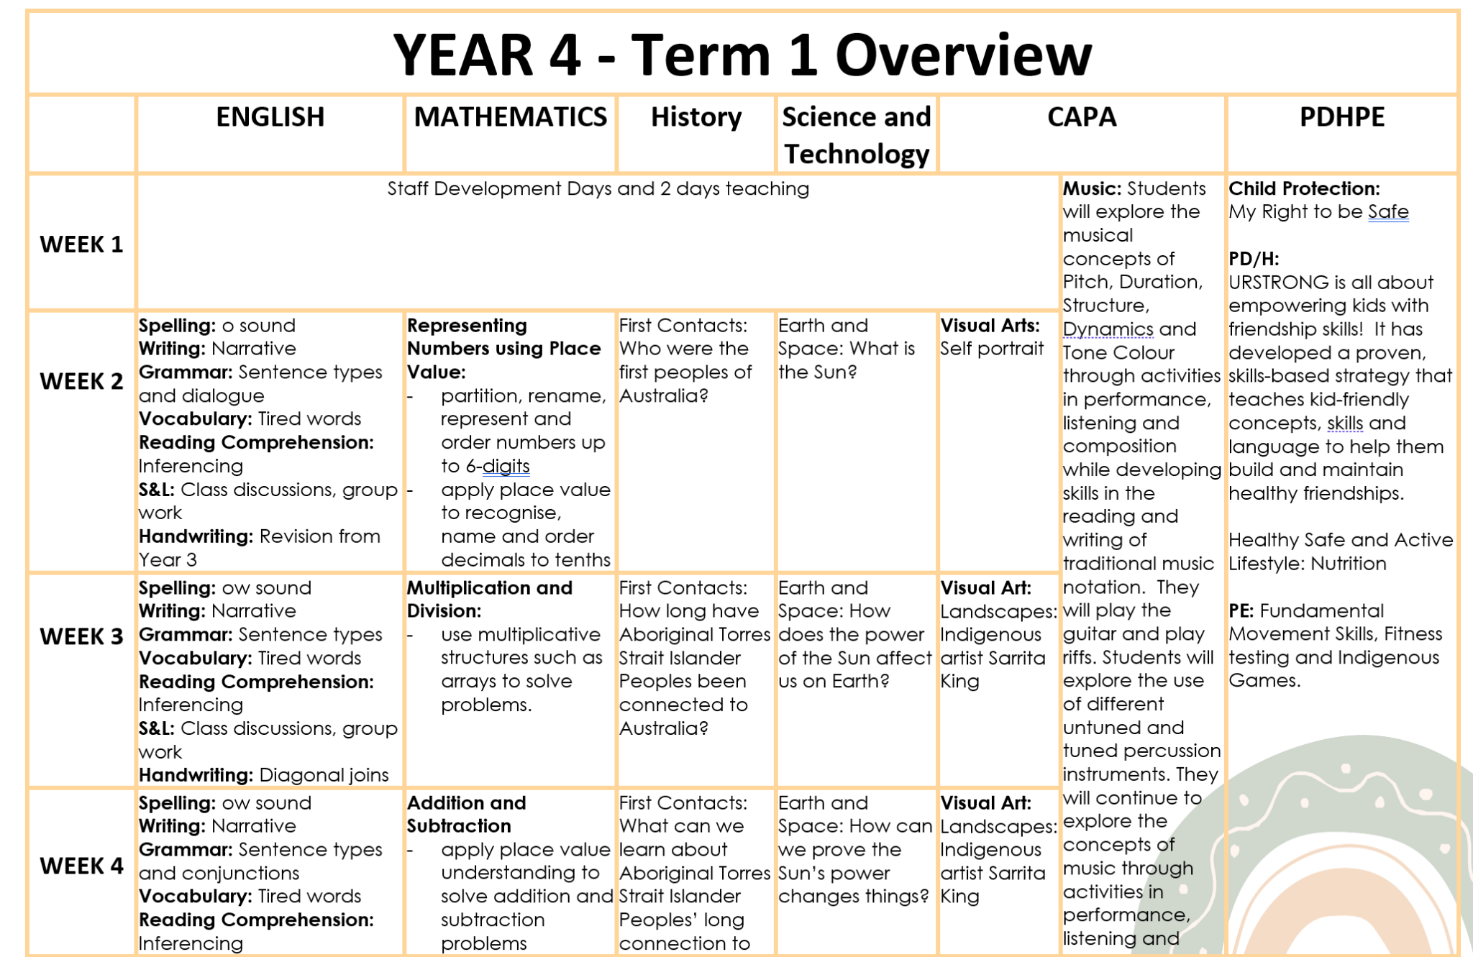
Term overview
Year 4 Term overviews can be viewed on the school website. A new term overview will be uploaded in the first couple of weeks of each term.
These are general overviews for the year 4 content being taught and teachers will differentiate the learning to suit varied student abilities.

Slide 12
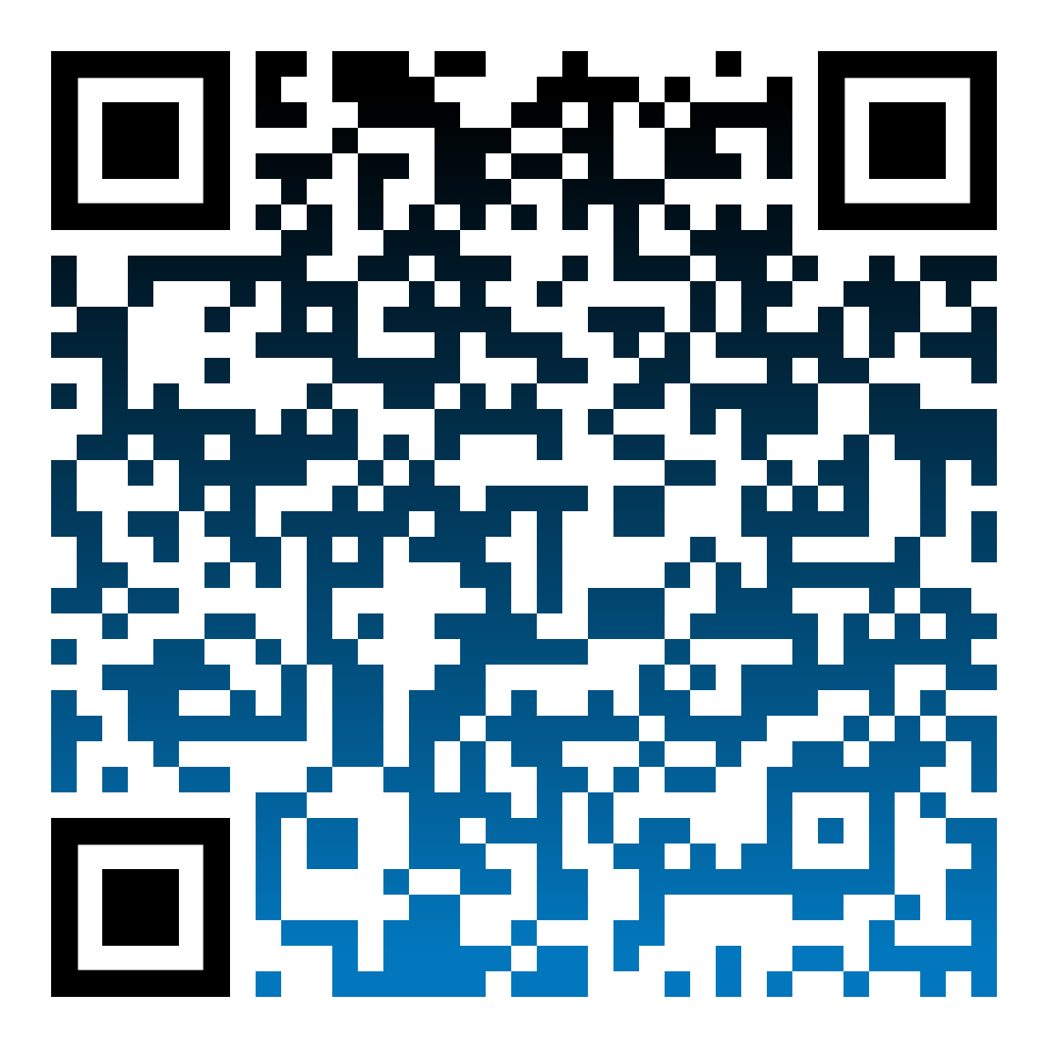
NEW CURRICULUM K-6
The new curriculum, gives students more time to focus on key learning areas so that they can acquire a deeper understanding of central concepts. It will ensure students develop strong foundations for learning, life and work.
The new curriculum is underpinned by extensive research and encompasses many aspects of schooling, including teaching, learning, assessment and reporting to parents. Some key curriculum changes include:
Building strong foundations for future learning with new English and Mathematics syllabuses
The new syllabuses focus on what is essential to know and do in early and middle years of schooling, and key learning areas in the senior years
Providing more time for teaching by reducing the hours teachers spend on extra-curricular topics and issues and compliance requirements
For more information and/or queries around the new curriculum and its implementation at MVPS contact our Assistant Principal, Curriculum & Instruction:
Elise Milotic (elise.milotic@det.nsw.edu.au) Erin Jones (erin.jones2@det.nsw.edu.au).
For more information on how you can support your child at home in regards to the new curriculum scan the QR code.

Slide 13
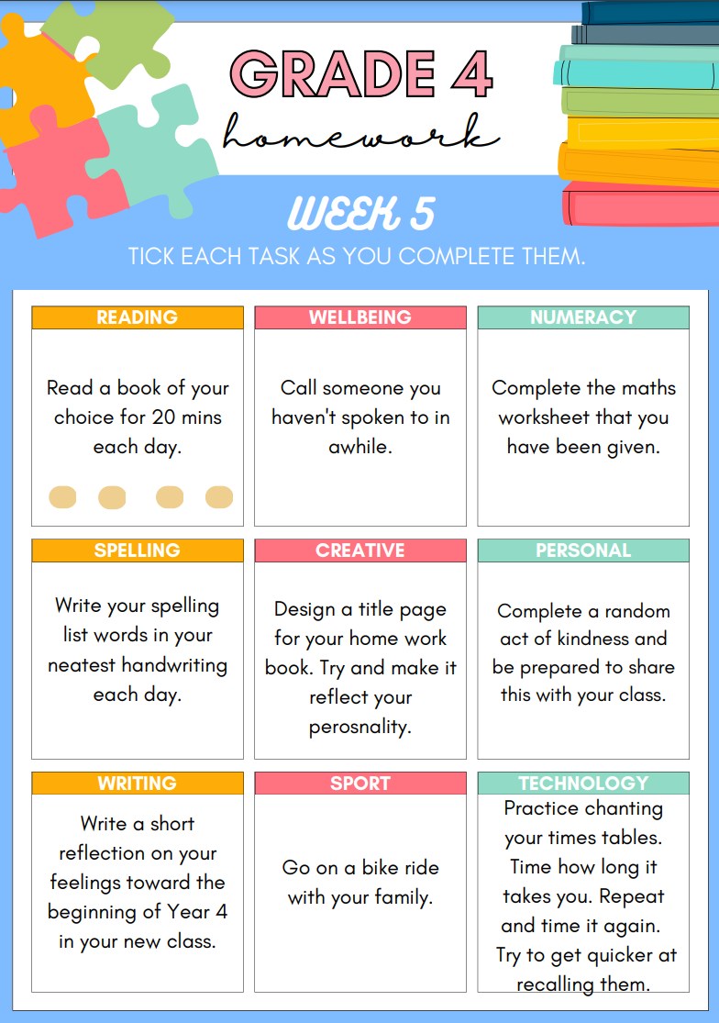
Home learning (homework)
Home learning activities for Year 4:
Must do:
Reading each day
Recommended:
Choose one activity from each column
We would like to encourage students to begin
healthy home learning habits, but understand
that many students already have busy afternoons

Slide 14
Our School Values

Slide 15
Social Emotional Learning (SEL)
Friendology and U R Strong (Term 1)

Slide 16
Social Emotional Learning (SEL)
Bounce back (Term 2-4)

Slide 17
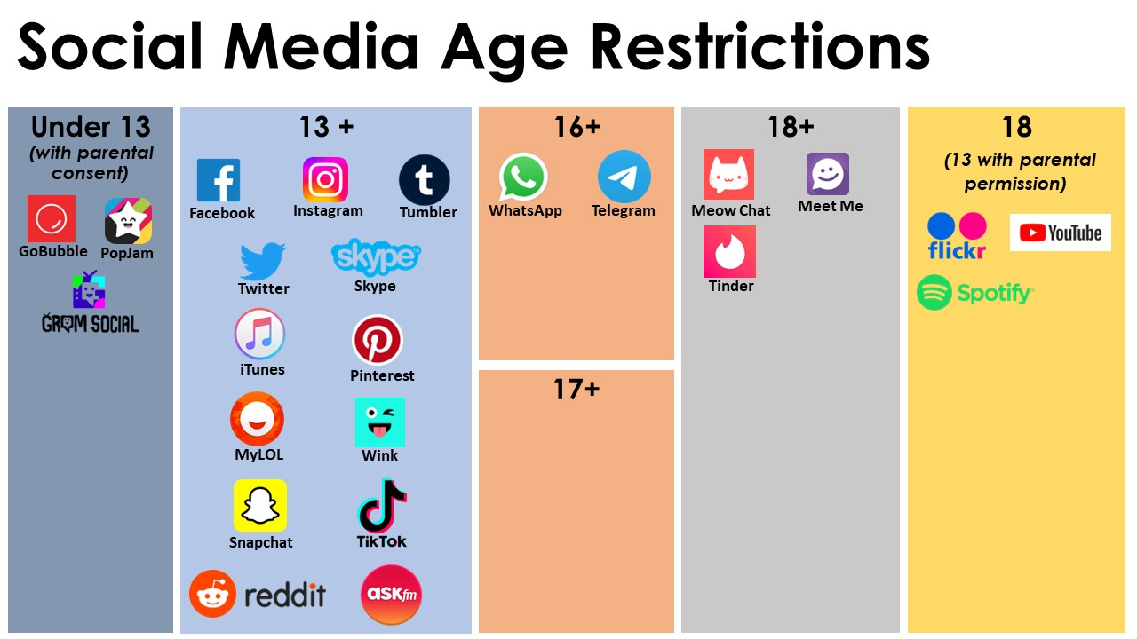
Social Media Age Restrictions
Smart Watches:
If your child has a smart watch, these will need to be kept in their school bag during the day unless calling and messaging functions are disabled.
Mobile Phone use:
Student’s mobile phones must stay in their bags at all times. They are not be used at any time within the school gates.

Slide 18
Contact details
Class | Teacher | Contact Details
Grade Leader | Miss Jess Brilman
4 Blue | Miss Abbey Eyre
4 Lime | Miss Bethany Whittington
4 Orange | Mrs Tara Sheppard
4 Purple | Mr Lachlan Stewart

Slide 19
Thank you for attending our Meet the Teacher Evening!

